Slide 1

オープンソースと共生する Microsoft Azure オープンソースへの貢献とその成果のご紹介
日本マイクロソフト株式会社

Slide 2

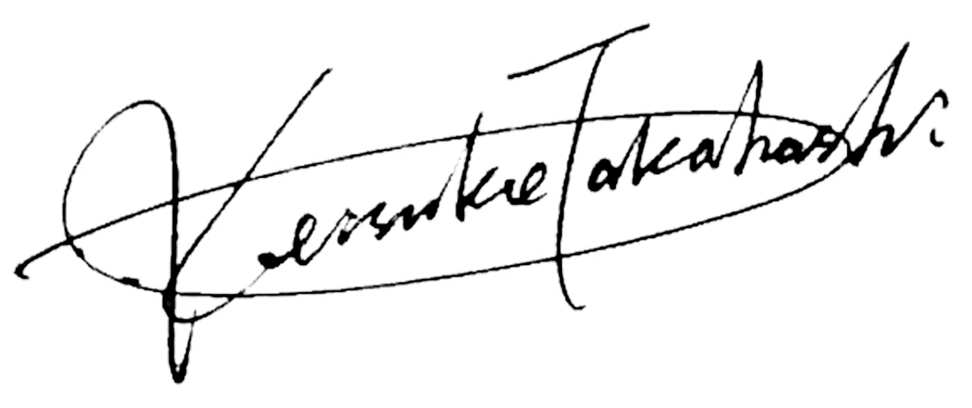




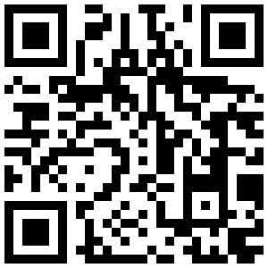
自己紹介
髙橋 敬祐 (たかはし けいすけ)
Cloud Solution Architect (Data&AI), Microsoft
新規事業立ち上げにかかる ソフトウェア開発, AI開発, データ分析, データ基盤 を多数経験
グローバルな開発コミュニティの Advisory Board Member 含む オープンソース活動 多数
MS入社後、PostgreSQL に関するイベント講演 (PostgreSQL Conference Japan 2021, Citus Con 2022)
プログラミング歴26年, オープンソース歴23年
keisuketakahashi
@k14i

Slide 3
エグゼクティブ・サマリ
Microsoft はオープンソースにコミットし、人材と資金の両面で投資をすることで、その発展に貢献しています。
Microsoft はオープンソースをサービスに取り込むことで、その価値をお客様にお届けしています。
その特筆すべき一例として、Azure における PostgreSQL をご紹介します。オープンソースと共生する Microsoft ならではの価値提供形態をご覧ください。

Slide 4
>40%
の CIO がオープンソースを最優先のソフトウェア戦略と考えている¹
オープンソースは
ソフトウェアの作り方を
変えています
96%
のデプロイされたアプリケーションでオープンソースソフトウェアが使われている²
80–90%
新規アプリケーションにおけるコードがオープンソース由来である²
¹Forrester 2017: Microsoft CMR, Altoros 2016–2017 trends in Open Source
²Synopsis 2018: Open Source Security and Risk Analysis
Notes:
Open Source has changed software development. It’s not the same as it was, even as recently as 1-2 years ago. No single person or team can make the progress that we can all make together.
Currently 96% of deployed applications have open source software in them. Open source within your codebase is growing too, and it’s because every new application you build today starts with open source as a basis.
In fact, those new applications are made of 80-90% OSS software. That other 10-20% is where the most innovative companies are investing their time and resources.
Open source serves as the infrastructure that lets innovative companies focus on their core competencies and win their markets. Whether you know it or not, you’re already using it – and you need to use it to keep up with the pace of industry innovations.
Source: Synopsis 2018 Open Source Security and Risk Analysis (https://www.synopsys.com/content/dam/synopsys/sig-assets/reports/2018-ossra.pdf)

Slide 5
オープンソースは 組織にとって 最大の差別化要因です
+30%
よりイノベーティブに
+20%
開発者の満足度と
定着率
McKinsey & Company: Developer Velocity: How software excellence fuels business performance. April 2020
Notes:
Open Source is also a key differentiator for Enterprises interested in driving digital transformation efforts that lead to better business outcomes.
Based on the McKinsey research, open-source adoption is the biggest differentiator for top performing organizations.
These organizations are seeing 3X more impact from the adoption of open source than the rest of the industry.
Organizations who are best in class on open source capabilities also score 30% higher on innovation and 20% higher on developer satisfaction.
Open source adoption is not just about the use of open source code or technologies.
It’s about embracing an open source mindset—creating a culture of knowledge sharing and contributing to software development to realize the collective power of a broader development team or community.
Notes should include how Microsoft is seeing this too.

Slide 6
150K
毎月のオープンソースのコンポーネント数
30K+
オープンソースは
Microsoft の
コアにあります
会社の ID と紐付けられた GitHub のアカウントを Microsoft 社員が保持
5.1M
使用中のコンポーネント数
Notes:
Microsoft has a strong open source program that encourages contribution, respects license obligations, and allows engineers to use open source with ease, work in the open, release projects, and be secure.

Slide 7

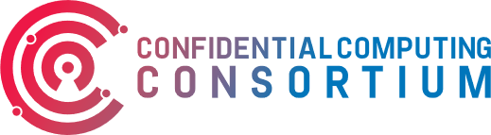



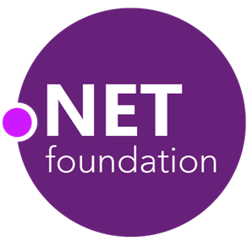

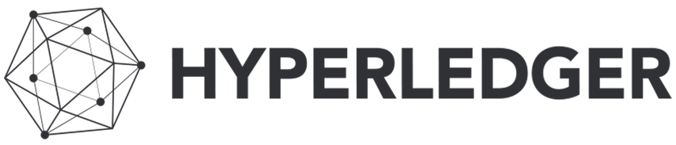




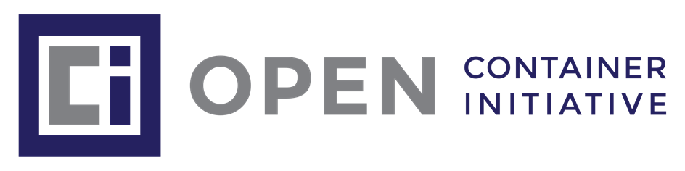
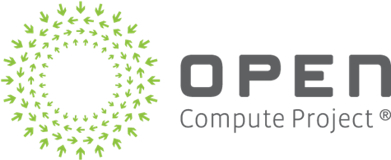
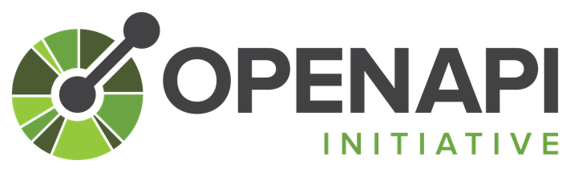

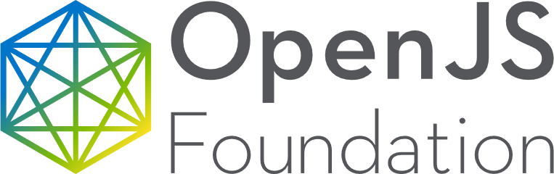




ファウンデーション
Alliance for Open Media
Notes:
Get logos from here: https://opensource.microsoft.com/ecosystem/ (Scroll down page)​

Slide 8
Azure におけるオープンソースのモメンタム
>50%
>60%
>47K
>100K
の VM のコアが
Linux で稼働中
の Azure マーケットプレイスのイメージが Linux ベース
の顧客が Azure のオープンソースデータベースを利用中
の Azure Data Studio インスタンスが Azure のオープンソースのデータベース用拡張を利用

Slide 9
>50%
>60%
Azure best-in-class Linux infrastructure
of VM cores are Linux
of Azure marketplace images are Linux-based
1/3
Top 100
of Microsoft's own cloud usage runs on Linux
Microsoft customers deploy Linux workloads on Azure

Slide 10





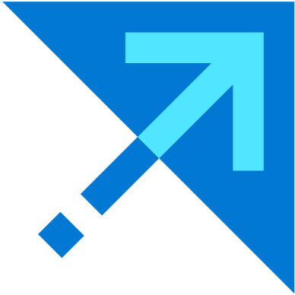
Azure HDInsight
Enterprise-ready managed cluster platform for open source analytics in the cloud
100% open source
Microsoft supported distribution of Apache Hadoop and Spark with full compatibility with the latest version of Hadoop
Customizable and extensible
Empower customers to deploy their own custom apps to meet their unique requirements
Enterprise-ready
Get enterprise-grade security and industry-leading compliance, with more than 30 certifications
Notes:
Azure HDInsight is provides a fully managed service for your open source big data needs. Since our inception, we have been dedicated to the spirit and community of open source. Starting July 2020, Microsoft began supporting our distribution of Apache clusters full in-house, thus deepening our commitment to being 100% open.
With HDInsight, customers get all the benefits of open source analytics, but with the security, cost control, and enterprise-readiness of Azure. HDInsight is a managed cluster service that is integrated with other Azure services, including Azure Storage, Azure Networking and Monitoring. The native development capabilities and unified experience makes HDInsight developer-friendly, while its data science features boost data scientist productivity and makes implementation easy for IT administrators.

Slide 11

Responsible ML toolkits
Open source ML toolkits enabling data scientists and developers to innovate responsibly
Fairlearn
InterpretML
Differential privacy
Confidential ML
Data sheets
Understand
Gain visibility into your models, explain model behavior, and detect and mitigate unfairness—all with out-of-the-box visualizations
Protect
Apply differential privacy techniques to protect sensitive data and prevent leaks. Encrypt data and build models in a secure environment to maintain confidentiality
Control
Use built-in lineage and audit trial capabilities and enable responsible process by documenting model metadata to meet regulatory requirements
Notes:
Understand, protect, and control your data, models, and processes to build trusted solutions, with machine learning toolkits that are fully open source. State-of-the-art technology enabling responsible ML development, deployment, and use. Put responsible AI principles into practice and build trust throughout the ML lifecycle.
Understand your models and build for fairness
Explain model behavior and uncover features that have the most impact on predictions. Use built-in explainers for both glass-box and black-box models during model training and inferencing. Use interactive visualizations to compare models and perform what-if analysis to improve model accuracy. Test your models for fairness using state-of-the-art algorithms. Mitigate unfairness throughout the ML lifecycle, compare mitigated models, and make intentional fairness versus accuracy trade-offs as desired.
Protect data privacy and confidentiality
Build models that preserve privacy using the latest innovations in differential privacy, which injects precise levels of statistical noise in data to limit the disclosure of sensitive information. Identify data leaks and intelligently limit repeat queries to manage exposure risk.
Use encryption and confidential machine learning (coming soon) techniques specifically designed for machine learning to securely build models using confidential data.
Control and govern through every step of the ML process
Access built-in capabilities to automatically track lineage and create an audit trial across the ML lifecycle. Obtain full visibility into the ML process by tracking datasets, models, experiments, code, and more. Use custom tags to implement model datasheets, document key model metadata, increase accountability, and ensure responsible process.

Slide 12

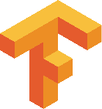



ONNX runtime
Open source runtime to optimize and accelerate ML inferencing and training
Supported Machine Learning Frameworks
Speed up machine learning process
Built-in optimizations that deliver up to 17X faster inferencing and up to 1.4X faster training
Plug into your existing technology stack
Support for a variety of frameworks, operating systems and hardware platforms
Build using proven technology
Used in Office 365, Visual Studio and Bing, delivering over 20 billion inferences every day
Notes:
ONNX Runtime is an open source project that is designed to accelerate machine learning across a wide range of frameworks, operating systems, and hardware platforms. It enables acceleration of machine learning inferencing across all of your deployment targets using a single set of API. ONNX Runtime automatically parses through your model to identify optimization opportunities and provides access to the best hardware acceleration available. ONNX Runtime also offers training acceleration (in preview), which incorporates innovations from Microsoft Research and is proven across production workloads like Office 365, Bing and Visual Studio.
Optimization and acceleration
Run any ONNX model using a single set of inference APIs that provide access to the best hardware acceleration available. Built-in optimization features trim and consolidate nodes without impacting model accuracy. Additionally, full backwards compatibility for ONNX and ONNX-ML ensures all ONNX models can be inferenced.
API and platform support
Take advantage of the benefits of ONNX Runtime without changing your technology stack. Access ONNX Runtime using your preferred API — C#, C++, C, Python, or Java. Support for Linux, Windows and Mac allows you to build and deploy applications without worry.
Continuous community innovation
Our community of partners and contributors drives constant innovation. Partners provide ONNX compatible compilers and accelerators to ensure models are as efficient as possible. Our contributor community improves ONNX Runtime by contributing code, ideas and feedback. Join us on GitHub.

Slide 13










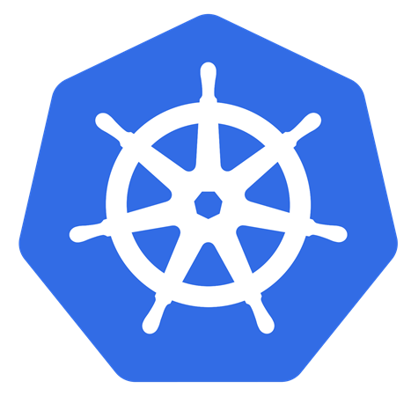




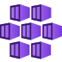

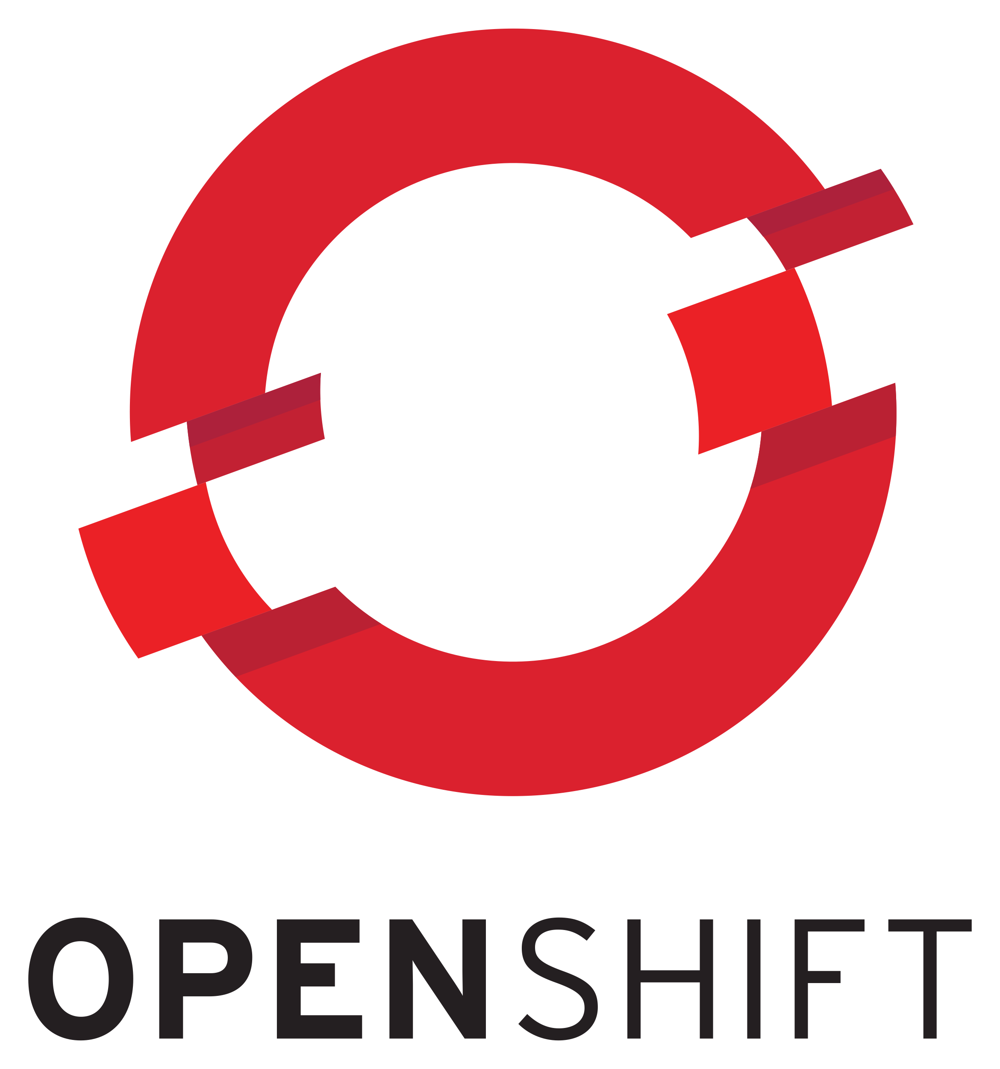

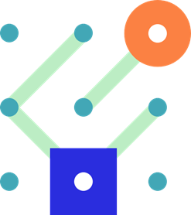








Kubernetes on Azure | Enterprise-grade by design
Development tools
Platform
Community
GitHub
Active Directory
Azure Policy
Security Center
Key Vault
Azure Advisor
Visual Studio Code
Azure Dev Spaces
Azure Kubernetes Service
Azure Container Instances
Azure Red Hat OpenShift
Azure Container Registry
Microsoft is part of this vibrant community and leads in the associated committees to help shape the future of Kubernetes and its ecosystem
Azure Monitor
Azure Arc Management across environments
CNCF platinum member
CNCF technical oversight committee
CNCF governing board
Kubernetes steering committee
Linux Foundation board member

Slide 14







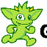

Azure Managed Databases
The best of the open source community combined with the advantages of Azure
Relational
Non-relational
Cache
Azure Database for PostgreSQL
Azure Database for MySQL
Azure Database for MariaDB
Azure Cosmos DB
Azure Cache for Redis
Community edition
Fully managed, community edition databases with open extension support
Open and flexible
API support for MongoDB, Cassandra, and Gremlin, and flexible deployment options
Enterprise-ready
Limitless scale, high availability, and advanced security
Notes:
Across our Azure managed databases, we bring top quality, enterprise-ready features to open source so customers that build on open source databases can focus on their applications and let us manage their databases. With a variety of features developed to bring application developers peace of mind, we are continuing to innovate and bring quality features to open source databases with Azure.
We give you the best of both worlds – all the benefits of the true open source communities coupled with the enterprise-ready features of Azure such as scale, high availability, security, and global reach, with our fully managed Azure Databases for Postgres, MySQL, and MariaDB, and Azure Cache for Redis. These databases are 100% community edition versions, with open extension support.
With our NoSQL database, Azure Cosmos DB, developers get API support for MongoDB, Cassandra, and Gremlin, and benefit from elastic scalability, and automatic data replication across any Azure region.
Each of these databases is fully managed, so you can focus on building innovative applications while Azure makes your job simpler. And you can rest assured that these databases are enterprise-ready, providing the scale, high availability, and security you need for your most mission-critical applications.

Slide 15

特筆すべき一例: PostgreSQL への投資と顧客価値への還元
Notes:
World's Best PostgreSQL on Azure
Overview & Roadmap: PostgreSQL at any scale with Citus

Slide 16
PostgreSQL は多くのDXにおけるコアとなっています
オープンソース
Large developer community
実証済みのレジリエンスと安定性
Thousands of mission critical workloads
リッチな機能セット
Solves a multitude of use cases
Low TCO; run anywhere
Extensible. Innovate faster with broad ecosystem
Battle tested
Enterprise-ready
Zero data loss
Rich indexing & data types, including geospatial
Flexible data: Relational & JSON
Notes:
So why is PG so popular?
Postgres is Open source which is financially palatable for many ☺
Huge community invested in building the product
Has consistent annual major releases with new functionality
This powerful functionality leads to both robustness
and the long history, 22 years, leads to stability.
So it’s battle tested and hardened
Lastly its viewed in the market as a platform to be confident in:
Some recent recognition is:
PG is continuously growing in popularity
Top in “most loved” and “wanted” by Stack Overflows ‘19 survey
DBMS of the year now 2 years in a row by DB-Engines
Now feature-wise [CLICK]
Sources:
https://insights.stackoverflow.com/survey/2019?utm_source=so-owned&utm_medium=blog&utm_campaign=dev-survey-2019&utm_content=launch-blog
https://db-engines.com/en/blog_post/76
https://db-engines.com/en/ranking_trend/system/PostgreSQL

Slide 17
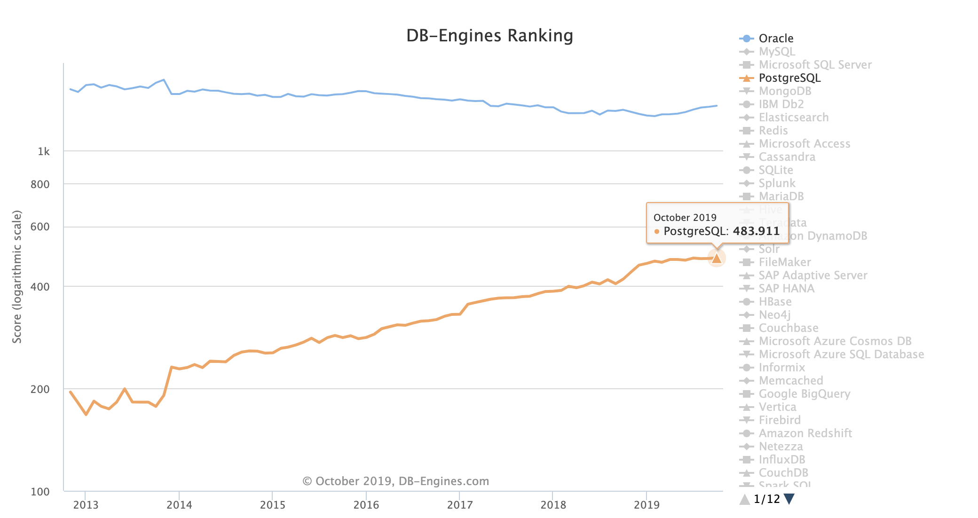
PostgreSQL is more popular than ever
PostgreSQL is more popular than ever
DB-Engines’ ranking of PostgreSQL popularity
One of the most loved and wanted databases in Stack Overflow’s 2019 Developer Survey
Ranked 2018 DBMS of the Year by DB-Engines
https://insights.stackoverflow.com/survey/2019?utm_source=so-owned&utm_medium=blog&utm_campaign=dev-survey-2019&utm_content=launch-blog
https://db-engines.com/en/blog_post/76
https://db-engines.com/en/ranking_trend/system/PostgreSQL
Notes:
So why is PG so popular?
Postgres is Open source which is financially palatable for many ☺
Huge community invested in building the product
Has consistent annual major releases with new functionality
This powerful functionality leads to both robustness
and the long history, 22 years, leads to stability.
So it’s battle tested and hardened
Lastly its viewed in the market as a platform to be confident in:
Some recent recognition is:
PG is continuously growing in popularity
Top in “most loved” and “wanted” by Stack Overflows ‘19 survey
DBMS of the year now 2 years in a row by DB-Engines
Now feature-wise [CLICK]
[IF NO FEATURE SLIDE]:
The community behind PG has contributed a lot to its development; including MSFT contributions.
For instance: [MAKE CONVERSATIONAL/FLUID]
Its not just Structured data. You can use semi-structured, key value, geo spatial, IP’s, etc – and you're also most likely able to index on those to increase speed & performance
PG has support for wide variety of indexes (json, gin, brin, btree, and others). Not just one type of index
And its not just storage but can query very fast
Built in functions which Citus also takes advantage of like mapping, to allow computation in the DB
Theres Functions to match and convert. Maybe for instance where a road intersects a lake.
But done w/in the DB
It has JSON
not just storage and retrieval but indexing w/in json objects
So with non relational and semi-structure data it uses the indexing concept for fast retrieval
And further you can extend PG to much more functionality by allowing extensions beyond just the core:
Examples are:
Postgis – geo spatial, (don’t start from scratch)
Time series – PG Partman or timescale for faster perf when querying on time,
Fast approximations to do count distinct or find 10 N object in a database with - HLL, TopN
and PGCron to run jobs w/in the DB
Postgres has a lot of functionality and worldwide engineer and developer support. BECAUSE of this PG is gaining momentum in both adoption and satisfaction while many other DB’s are stagnant on that chart.
Sources:
https://insights.stackoverflow.com/survey/2019?utm_source=so-owned&utm_medium=blog&utm_campaign=dev-survey-2019&utm_content=launch-blog
https://db-engines.com/en/blog_post/76
https://db-engines.com/en/ranking_trend/system/PostgreSQL

Slide 18

いくらでも、どこででも。 PostgreSQL の最良のホスト先は Azure です。
フルマネージド
セキュア &
コンプライアント
高度にスケーラブル
(分散 SQL with Citus)
PostgreSQL Core
オープンソース
実証済みのレジリエンスと安定性
リッチな機能セット
Azure データ
エコシステム
との統合
キーとなる差別化要素
あらゆる顧客のためのオープンでポータブルなエコシステム (対プロプライエタリ)
オンデマンドの高スケーラブル: 分散 SQL with Citus
Azure エコシステムとのシンプルな統合
Notes:
And last but definitely not the least, we provide integration points with Active Directory Integration, Azure Data Factory and PowerBI so that you can build your application end to end on Azure.

Slide 19

Azure Database for PostgreSQL のデプロイ選択肢
Single Server
Flexible Server
Hyperscale (Citus)
Fully-managed, single-node PostgreSQL database service with built-in HA
Example use cases
Transactional and operational analytics workloads
Apps requiring JSON, geospatial support, or full-text search
Cloud-native apps built with modern frameworks
Maximum control for your database with a simplified developer experience
Example use cases
Support for a variety of workloads with a new simplified architecture
High-performance apps utilizing zone co-location for low latency
Apps built on the latest Postgres versions
Worry-free PostgreSQL in the cloud with an architecture built to scale out
Example use cases
Scaling PostgreSQL multi-tenant, SaaS applications
Real-time operational analytics
Building high throughput transactional apps

Slide 20
Single server use cases
Apps requiring JSON, geospatial support, or full-text search
Cloud-native apps built with modern frameworks
Transactional and operational analytics workloads
Notes:
3 main UC’s we see commonly for PG

Slide 21



Apps requiring JSON, geospatial, full-text search
Azure Database for PostgreSQL
Build your application with both defined schema and unstructured NoSQL type data by leveraging Postgres JSON support
Postgres built-in query planner allows for efficient caching which is great for managing user session state
Advanced geospatial support allows you to layer in location-aware capabilities into your application
Integrated full text search provides rich interactions with data
Use scalable machine learning/deep learning techniques, to derive deeper insights from this data
5
3
Store geospatial e-commerce purchases
Azure Databricks
1
4
Product catalog - JSON
Browser
App Service
Azure Database for PostgreSQL Search
(Full-text index)
2
Session state
App Service
Notes:
Firstly apps that require using multiple types of data. Think eCommerce with recommendations and social data, health care medical records with text, Utilities / wind farms, etc with geospatial, ,
[STORY].
You have and [ecommerce] app that wants to notify clients about X or Y (think specific UC’s).
EXAMPLES
You could have a Product catalogue, Customer/HR Comments (text), Marketing may need geo spatial, sales volumes, products, individual human capital perf history etc
w/out PG you’d have to piece 3-4 db’s to piece together
With PG you can have it in one DB
with query planner you can maintain state, and cache in mem to use most recent data more often which leads to better performance
It has Geo special and full text search and
It connect to different tools (like databrick or ML platforms) using standard PG connectors
Joining all these types data and workloads w/in a single PG db

Slide 22


Cloud-native applications built with modern frameworks
Deploy and manage containerized applications easily with a continuous integration and delivery experience (CI/CD), and enterprise grade security and governance.
Focus on your app, not the database, with a fully managed database as a service for PostgreSQL. With built-in high availability and rich feature set of Postgres you can build design modern experiences free from legacy constraints.
Offload database demands by managing sessions state and asset caching with Azure Cache for Redis
Alert based on key events such as location or user activity using the serverless compute platform of Azure Functions.
Push timely notifications directly to your users on their preferred service or medium.
Use scalable machine learning/deep learning techniques, to derive deeper insights from this data using Python, R or Scala, with inbuilt notebook experiences in Azure Databricks.
Monitor your application’s performance for degradation or anomalies and auto-scale your application to changing performance requirements.
Browser
1
7
Content Delivery Network
Azure Kubernetes Service
Application Insights
2
3
5
4
Notification Hubs
Azure Functions
Azure Database for PostgreSQL
Azure Cache
for Redis
ML Recommendations
6
Azure Databricks
Notes:
Next;
[STORY].
Your clients has a cloud app that wants to host, measure and track the data but also act upon that data . Maybe notify clients about X or Y; maybe cros sell opps for an ERP or HCM saas application or giving clients of your customers recommendations on new financial offerings that seem to be a fit based on the individuals data like financial advisors would like.
With cloud native apps you need a SOR. PG can be that source and feed other MSFT tools for the entire infrastructure to build, maintain the app and reach out to the end users if opportunities are seen w/in the data in the DB.
Not only that but with Kubernetes to make portable as your clients continue to improve the application and their client experience.
_____________
Certain frameworks have an affinity to certain DB’s
Django or rails are heavily tied to PG
Great drivers for PG db so they are a natural fit.
And Kubernetes can connect to the DB and run them in Django
Azure PG will provide the entire INFRA to build the app.
Its managed
You can offload managed session states and caching with our tool like Azure Cache for Redis
We provide notifications to customers with azure notification hubs
and ML with Databricks
PG can be a SOR for cloud native applications and can be the engine since all of these have connectivity to PG

Slide 23

Transactional and operational analytics workloads
Receive telemetry on state of your devices and message routes from billions of devices
Ingest data into a transactional database that allows you to performantly query timeseries data with richness of SQL
Perform offline rich machine learning or train predictive models
Report and visualize the state of your devices at a granular or aggregated level
Provide insights to users and operators on current device status
Browser
Azure Database
for PostgreSQL
1
2
5
Device
Azure IoT Hub
App Service
Timescale
3
4
Azure Databricks
Power BI
Notes:
3rd workload is MIXED LOADS. Transactional and operational Analytics. Not just good for reads but Iot and high ingest write workloads too.
Great for:
Utilities:
either grid optimization or even smart metering reporting
Need geo spacial
Manufacturers:
tracking plant level data perhaps around plant productivity
preventative maintenance
Even utility usage w/in a building
Mixed workloads where its not just about seeing the data fast and feeding that data to AI or ML like Databricks to make quick decisions that can control millions in productivity
but also needing the ability to bring in data fast so the reporting and AI is being run against relevant data
Same with Autonomous vehicles. They have loads of data
they have the need to quickly identify anomalies
look at all the sensor measurements directly around and leading up to the anomaly
In most cases this requirements stem from a need to control waste; which is costs and safety
ingesting to transactional DB – use extension, like timescale, to ingest at high speeds and run complex queries on
Postgres is great at both operation and analytic workload, AGAIN, in same DB vs having to stitch multiple DB’s
It is a powerful OLTP engine but also gives great SQL support for complex queries with allows both OLAP and OLTP in same DB
LASTLY, you can connect tools like powerBI (tableau, Qlik) or your own, so you can process in the DB and display in the tools you prefer.
And It’s open because it's open source. We’re not using a fork that we’ve created as proprietary [nod to AWS]

Slide 24


Azure はオープンソース・イノベーションにコミットします
PostgreSQL への貢献
To コミュニティ
And more, including:
pg_auto_failover
cstore_fdw
hll
pg_cron
topN
Azure Data Studio
Extension
Visual Studio Code
Extension
Citus Community
Extension
With コミュニティ
PostgreSQL Project
Hasura

Slide 25
Microsoft が作成・メンテナンスする拡張機能
Scales out Postgres across multiple nodes via sharding & replication
Columnar storage for analytics with Postgres
Implementation of HyperLogLog for fast accurate distributed distinct counts
Cron-based job scheduler to Run periodic jobs in PostgreSQL
Efficiently return top items in a very large dataset
Citus
cstore_fdw
hll
pg_cron
topN

Slide 26
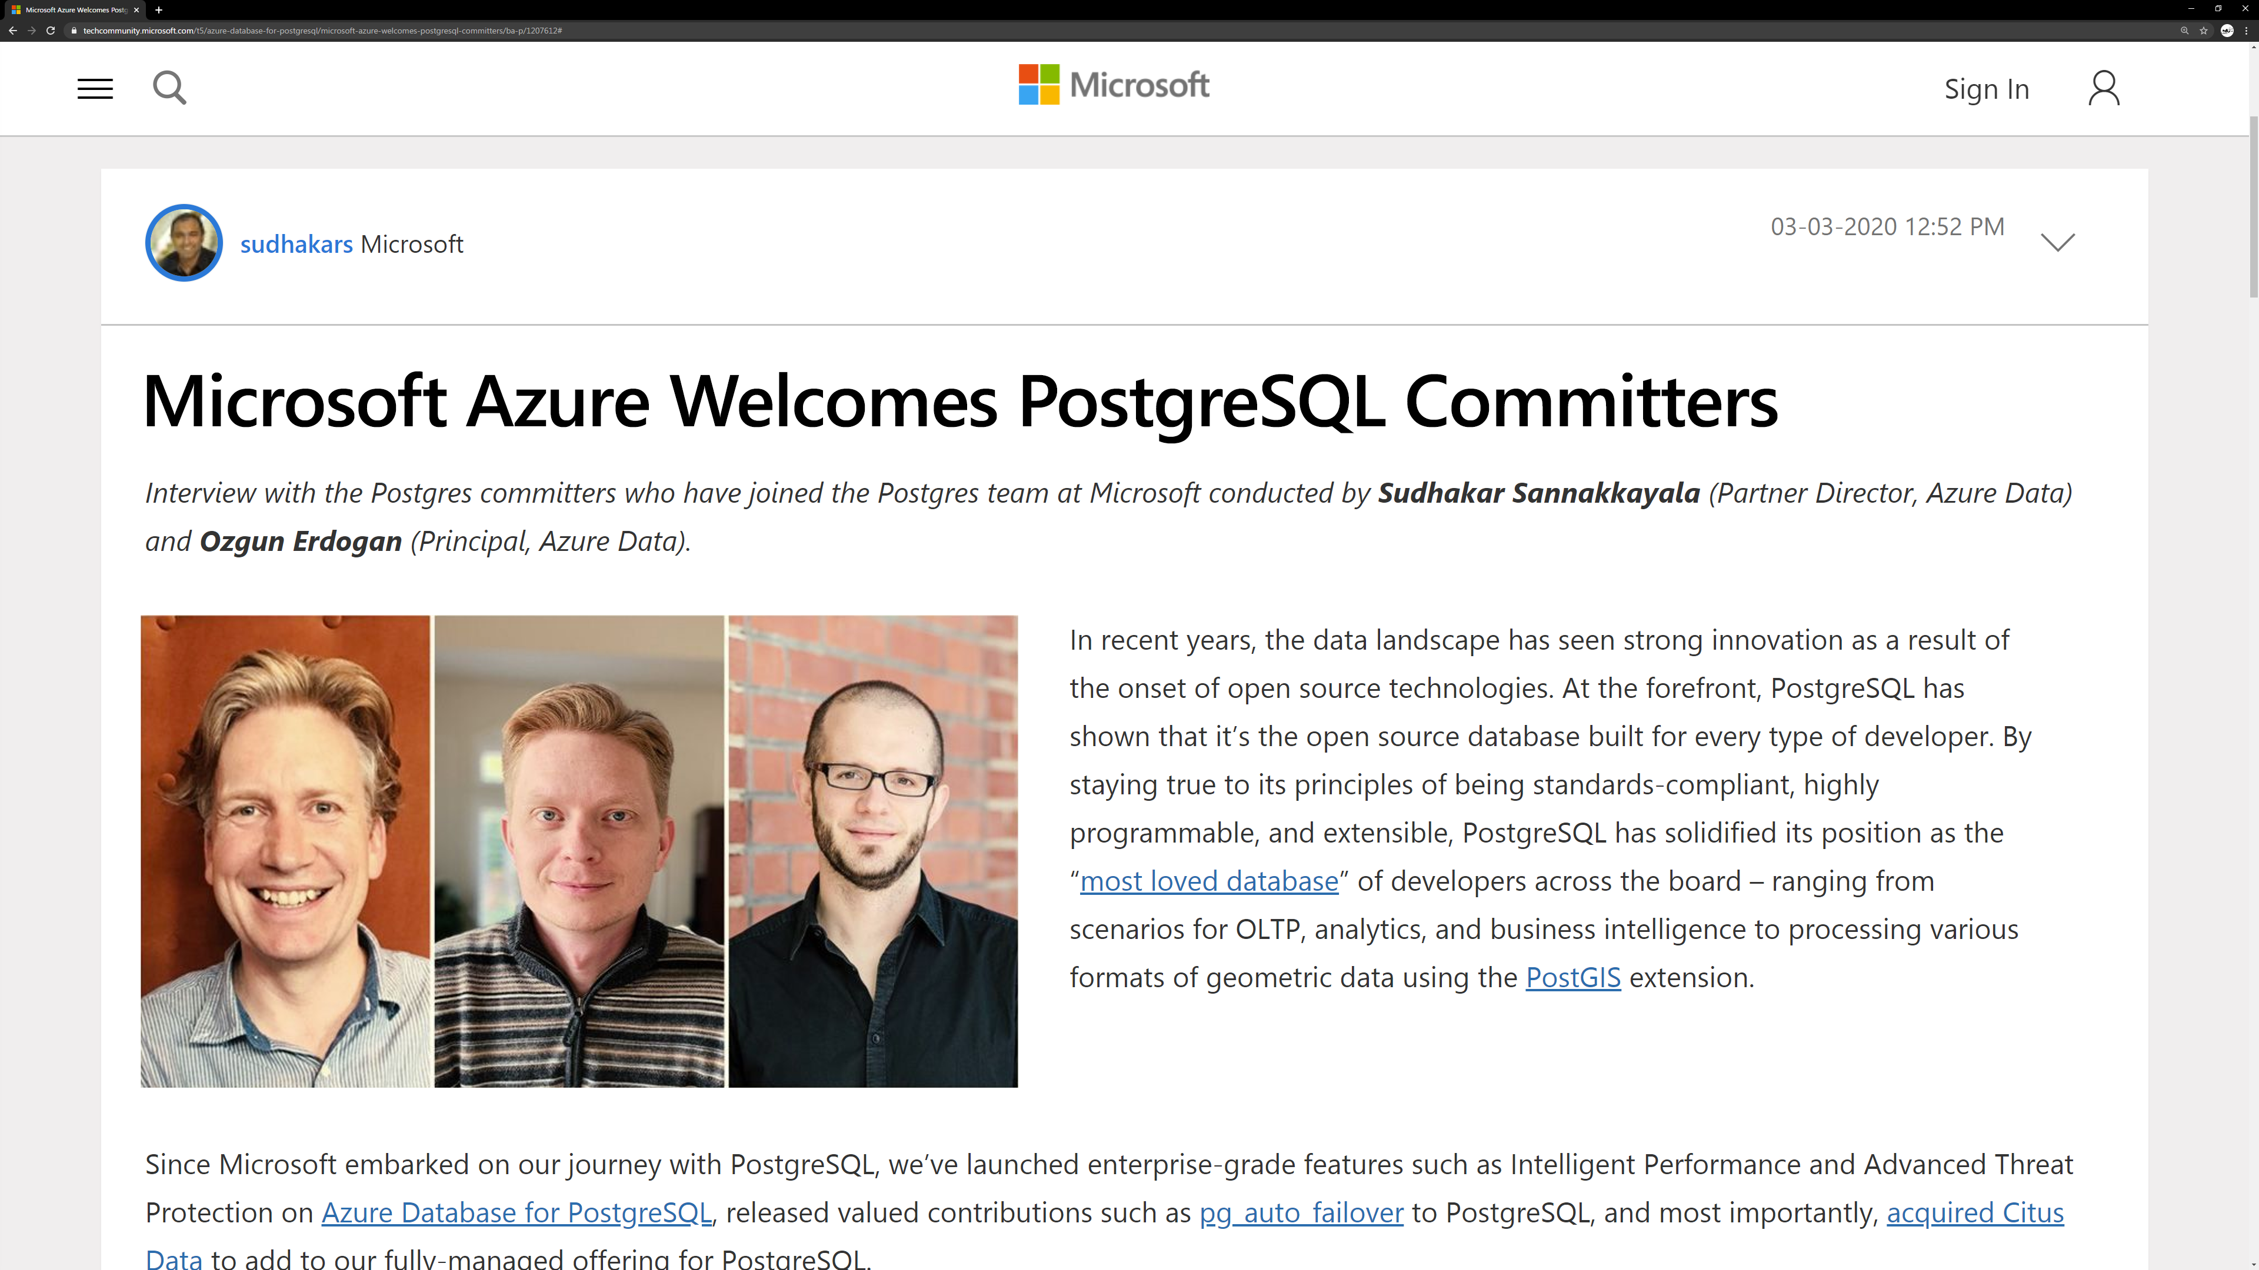
Microsoft Azure Welcomes PostgreSQL Committers
aka.ms/blog-postgres-committers

Slide 27
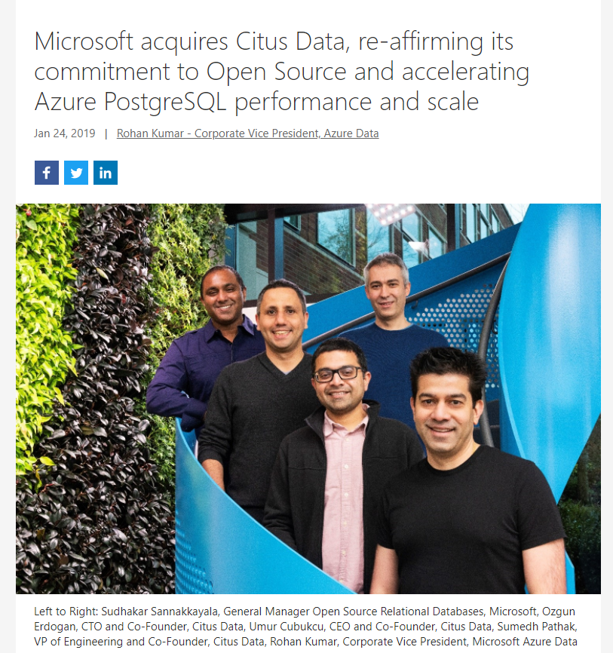

2019年 Microsoft は Citus Data を買収

Slide 28
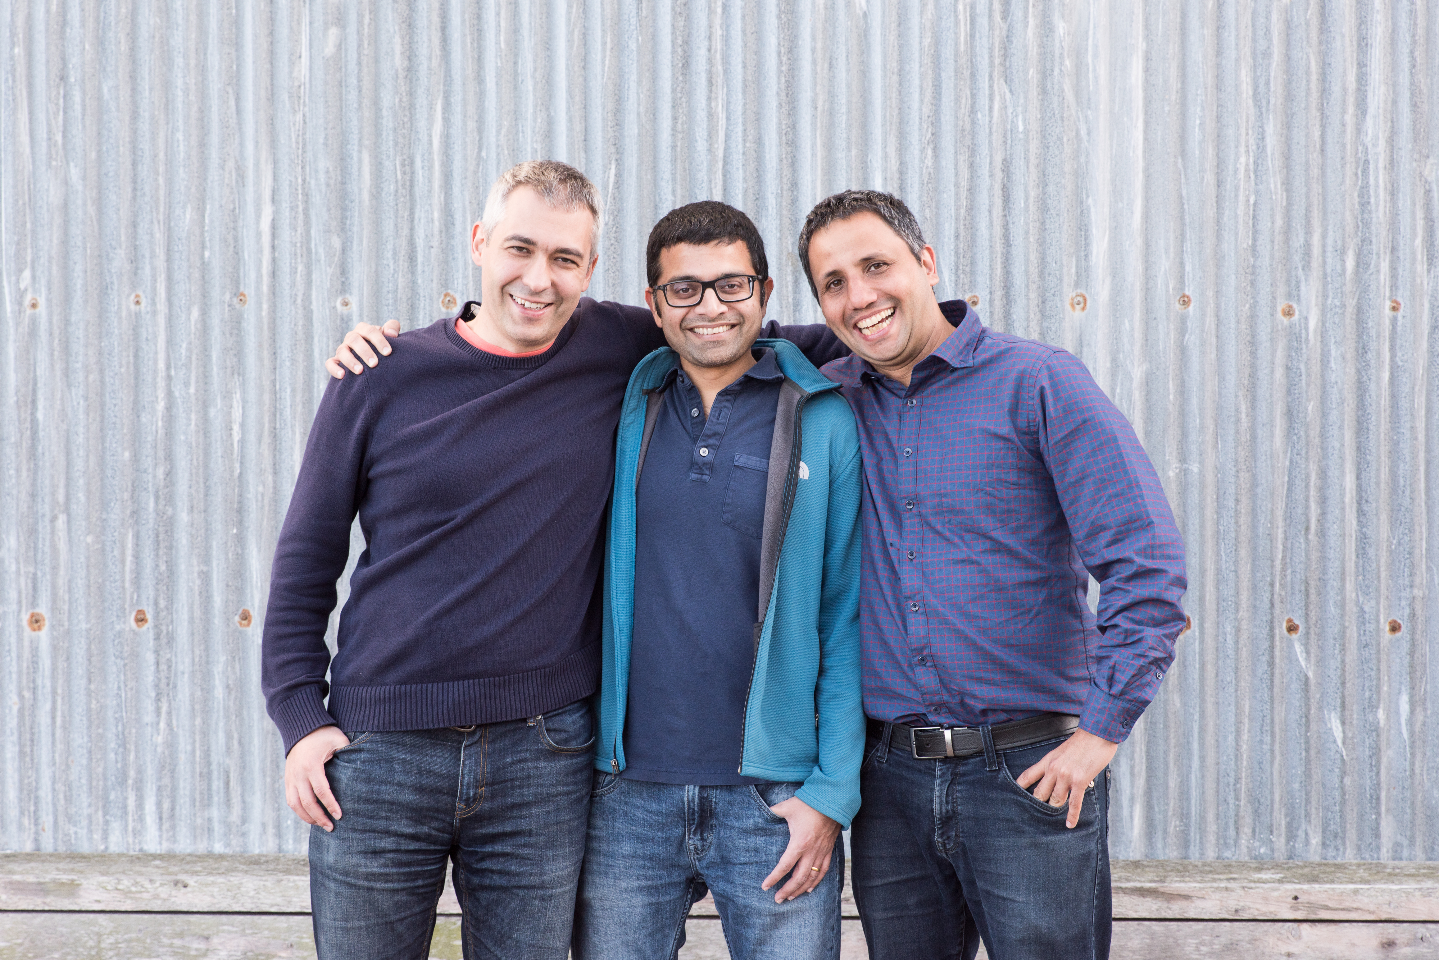

Citus Data was founded 9 years ago to change what’s possible with Postgres

Slide 29

Azure Database for PostgreSQL Hyperscale (Citus)

Slide 30
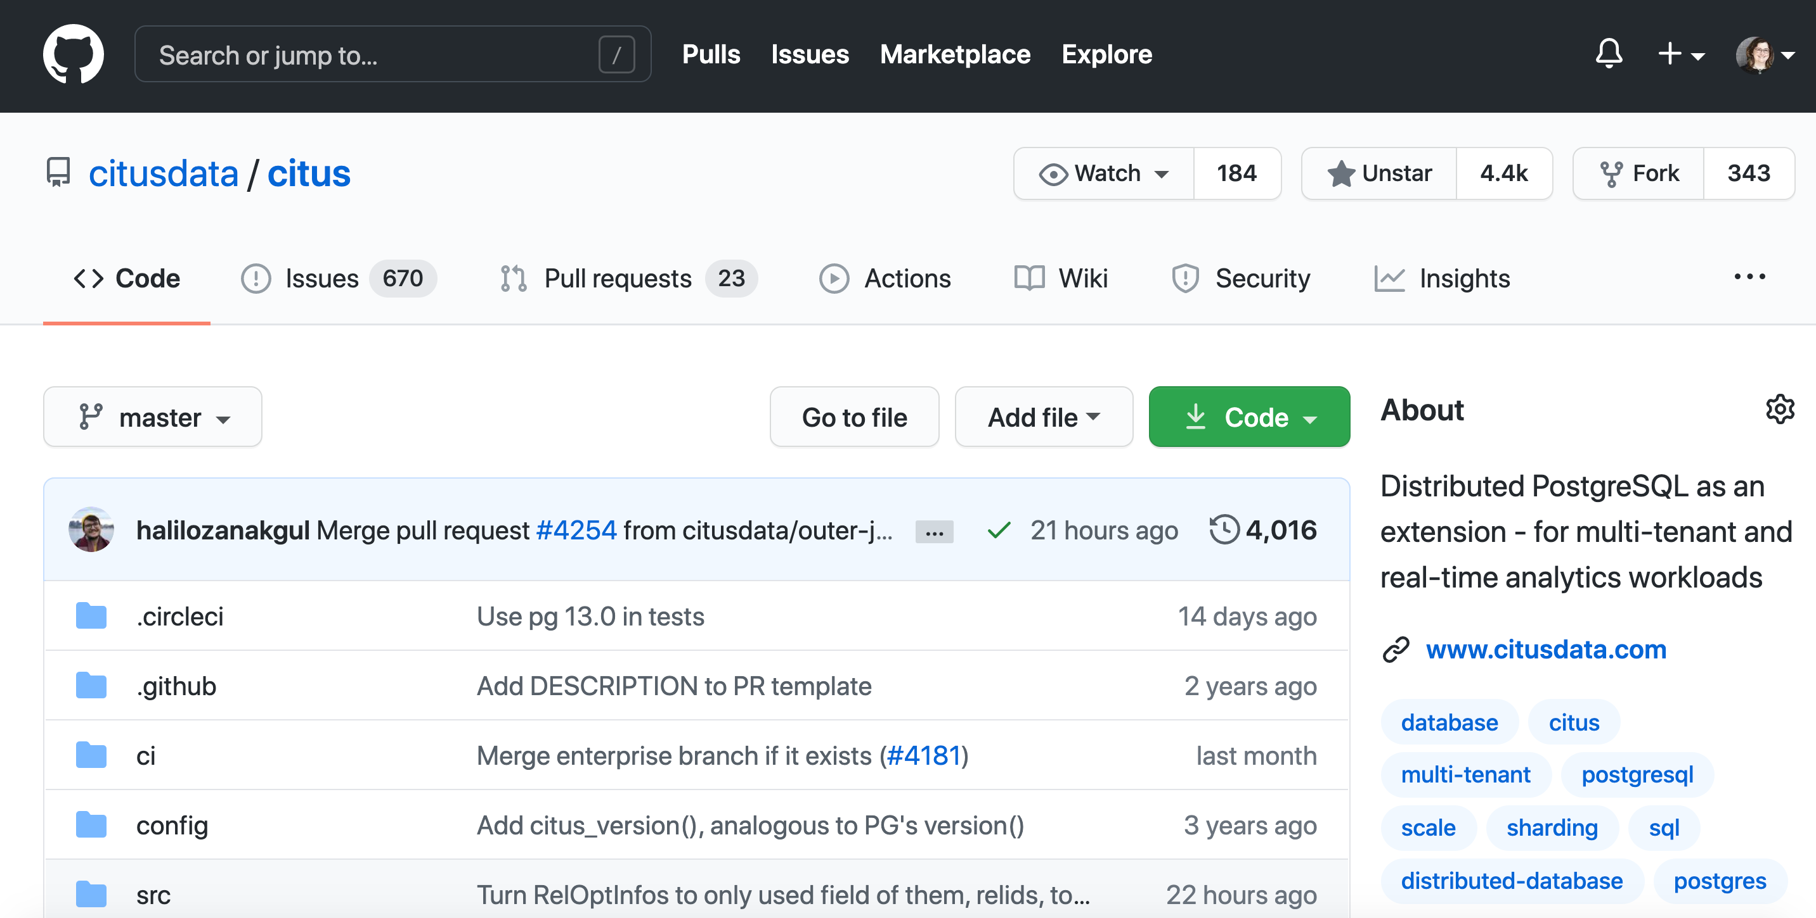
aka.ms/citus

Slide 31
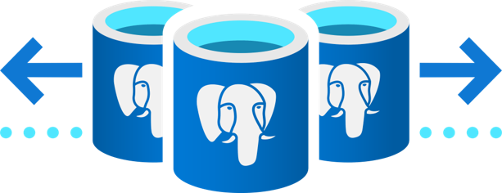
Azure PostgreSQL for PostgreSQL Hyperscale (Citus)
ノード間でデータとクエリが分散し、無制限の水平スケーラビリティを提供する PostgreSQL データベース
複数ノードに渡って PostgreSQL データベースをシャーディングすることにより、アプリケーションはより多くのメモリと計算リソースを利用可能に
オープンソースの Citus 拡張によって実現され、 Azure 上で管理される

Slide 32
Citus Community と Hyperscale (Citus) の違い
機能 / 要素 | Citus Community | Hyperscale (Citus)
以下を含めたコア機能: Horizontal Scaling via sharding, extension of PostgreSQL, scaled-out Query Engine & Massive Parallelism Broad data type support, including: JSONB, GIS, Hyperloglog , TopN support for analytics
ゼロダウンタイムでの自動リバランスワークロード
データ配置のコントロール – テナント分離
セキュリティ – きめ細かなアクセスコントロール
サポート – エンタープライズ向け技術サポート (アーキテクチャに関する支援を含む)

Slide 33
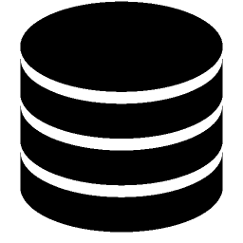
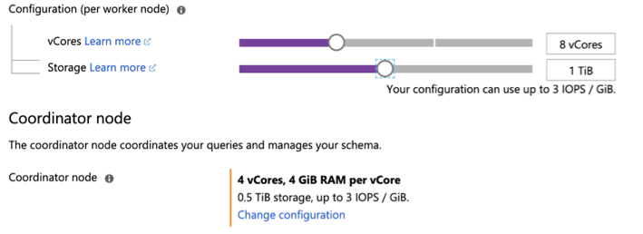
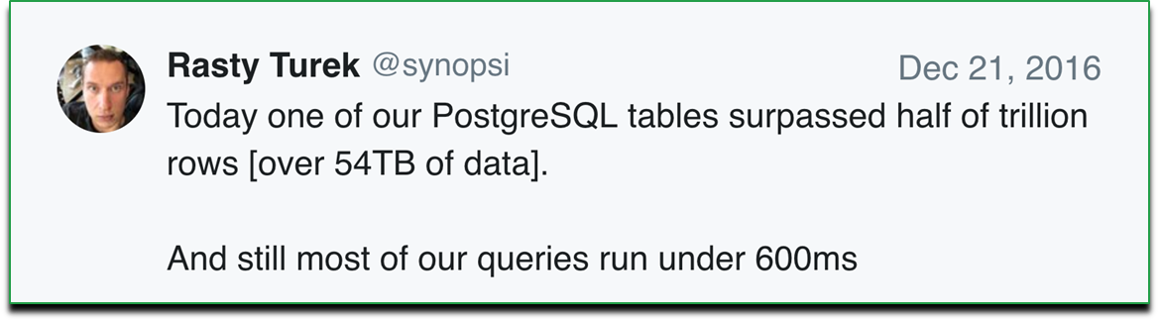

実証された PostgreSQL の水平スケーリング
Block growth on 1 (monolithic) database
Grow to 100s of database nodes, while preserving the power of PostgreSQL
Total Nodes
18
vs
Notes:
So you never have to worry about your database again

Slide 34
Why Hyperscale (Citus)? Making PostgreSQL future-proof, at any scale
Block growth on 1 (monolithic) database
vs.
Grow to 100’s of database nodes, without re-architecting your application
Total Nodes
18
Notes:
So you never have to worry about your database again

Slide 35
Hyperscale (Citus) がエンパワーする 顧客向け商用アプリの3つのキーとなるワークロード
リアルタイム分析処理
マルチテナント & SaaS アプリ
オンライン トランザクション
処理
Scale your database with 10s of TBs memory, 1,000s of CPUs.
Enable sub-second query responses, across billons of records. NoETL.
Use JSON + structured data together. Parallelize across nodes for 100x performance.
Scale beyond single node
Minimize hotspots by spreading out tenants
Rebalance data fully online
Isolate large tenants to their own hardware
Ensure high performance with concurrent users
Avoid single points of failure
Distribute transaction processes across multiple nodes
Manage high volumes of transactions
トランザクション＋分析
コアなトランザクション

Slide 36
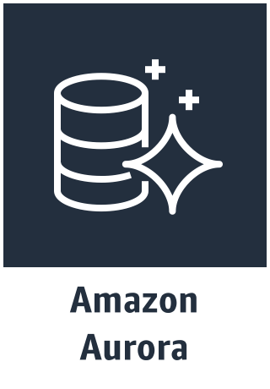
Real-time operational analytics reporting
Sub-second queries on billions of events.
Parallelize SQL & deliver millisecond responses.
Query JSON, geospatial + structured data together
Leverage Postgres: Reliability, rich data types, extensions, & expertise.
Build with open source. Avoid lock-in.
Power customer-facing dashboards (low-latency, high-throughput apps) with many concurrent users
Analyze new events as they happen. Put real-time data in context with past actions, in one database.
No ETL: Perform in-database roll-ups & pre-aggregates, without new data pipelines.
Avoid stitching together multiple different database technologies to get the job done.
Lower costs: better use of compute, memory, and storage
Sub-second responses across many users (high concurrency)
Analyze your writes -- without separate ETL (w/o cost & delay)
Easy to add new nodes
Evolve with large, open source ecosystem
Faster: Parallel queries and indexing
Azure Postgres with Citus “scale out”
Limited compute and memory scaling to single node. Storage scale out limited to 64 TB.
Limited user concurrency and may require to move data to redshift for analytics
Performance: Resource utilization
Proprietary fork of Postgres. Locks you to a AWS.

Slide 37
Scaling multi-tenant / SaaS applications
Build applications that scale simply from one tenant to 100,000s
Need a database with performance that can support the growth of your SaaS business.
Build with open source. Avoid lock-in.
Take advantage of Postgres reliability, data types, extensions, toolset, & expertise.
Don’t want to divert developers from core business app to spend on database optimizations.
Need to enable developers to experiment & analysts to analyze, without production impact
Easier to build with Postgres you love and leverage existing Postgres ecosystem: single database
Easier to maintain with familiar Postgres tools (same team, no additional cost)
Better resource utilization (unparalleled performance with scale)
Azure Postgres with Citus “scale out”
Need to modify & teach your application “sharding”
Development heavy: Custom eng’g for distributed systems; Consistency, replication, failure handling, sharing & querying data across tenants, isolation
Fragile to maintain one massive database (longer to replicate, create index, change schema, vacuum, backup, upgrade, etc.)
DevOps heavy: Backups, adding new nodes, changing schemas
Performance: Resource utilization
Proprietary fork of Postgres. Locks you to a AWS.

Slide 38
High-throughput transactional / OLTP applications
Power of SQL and globally consistent transactions at scale with low latency
Combine the power of relational semantics, with horizontal scalability
Simplify your application development, without re-architecting your applications just for scale
Leverage Postgres: Reliability, rich data types, extensions, & expertise.
Build with open source. Avoid lock-in.
Cut costs and reduce data duplication. Use high-performance JOINs, or combine with json data when you want to.
Keep millisecond responses, while growing to 100’s of terabytes of data.
Lower costs: better use of memory, and storage scaling. Does not need to split into multiple DBs
Sub-second responses across many users (high concurrency)
Easy to add new nodes
Evolve with large, open source ecosystem
Faster: load and indexing
Azure Postgres with Citus “scale out”
Limited compute and memory scaling to single node. Storage scale out limited to 64 TB.
Performance deteriorates with increased user concurrency
Performance: Resource utilization
Proprietary fork of Postgres. Locks you to a AWS.

Slide 39
Real-time operational analytics and reporting
Hyperscale (Citus)
Stream millions of events per second from devices and sensors into a scalable system that speaks and understands Apache Kafka. Build downstream pipelines to process, manipulate, and ingest your data
Ingest millions of raw transactional events into Hyperscale (Citus) per second, allowing you to query and alert on granular events
Perform incremental rollups directly in your database at granularities you define such as minutely, hourly, daily, to real-time reporting and dashboarding for down stream applications
Take advantage of Azure Databricks to clean, transform, and analyze the streaming data, and combine it with structured data from operational databases or data warehouses
Provide insights to users and operators on current device status
Push timely notifications directly to your users on their preferred service or medium
1
2
4
Devices
Event Hubs
Raw Events
Azure Databricks
3
Scheduled
process
5
4
Browser
App Service
Aggregations
6
Notification Hubs
Notes:
Realtime Is another sweet spot
Now can connect many tools (databricks, kaftka, and many others) to the db to have raw events, aggregations, and rollups,
You can Ingest very large data sets to the tune of millions writes / sec (batch), 50-100k single row inserts / sec (single row inserts)
while also showing sub second responses
This will help u build an entire analytics pipeline from event hub to the DB while using AppService and notifications
Great for any client who has a need for very fast reporting, dashboarding and analytics served up to leaders but also on a large set of data
[TALK TO PARRALISM and CONCURRRENCY]
___________________________________________________________________________________________________________
Comp is:
Azure SQL DW – datawarehouse – so beyond they are nosql and we are sql
They say fast analytics and similar architecture to us right? lol
True but more good for processing in batch, running over the whole data set
SAY (Citus):
We are hybrid – OLTP and OLAP
We bring hybrid for high throughput of ingest and high reads
10’s of k’s / sec
Quick and short requests
Higher concurrency on Citus
Cosmos
TCO high – you have to piece together Spark or HDInsight and processing in Spark and store & display in cosmos
Complexity high
Good when u know its key value and one type of workload
SAY (Citus):
SQL – relational but also good for semi-structure/JSON
TCO less with Citus because its flexible and you don’t need to piece spark, plus cosmos plus datalake
Complexity low – 1 solution vs piecing together multiple pieces
More flexible – PG joins, json, multiple workloads
MySQL (Oracle): 2nd Quadrant LINK – 1, 1(charter),
Bought by Oracle so now little by little going up. Was $5k/sever but now we see 10k/node
One of the two big OS Relational DB now only PG
Search for PG vs mysql – 2nd quadrants answers are good & Quora
Have good multimaster tool
Only ACID if using InnovDB and NDV cluster storage engines
Common to underperform when strained by heavy loads or complex queries
Better for reads
Does not support indexing for JSON – access speed impact
Only indexes on 1 (btree) while PG has 6 w/in PG along with more from the contributors
Does not support materialized views
Single language support – not extensible
Aurora:
Stepping Stone,
provisioning on Azure is a big leg up we have on AWS right now (41 minutes in Azure, 6 days on AWS).
#1 Aurora is PROPRIETARY vs. Citus = open source + run anywhere + NOT locked into one infrastructure
#2 Aurora ONLY SCALES 2 things: STORAGE & READ performance via max of 15 read-replicas. Whereas Citus can scale out compute, memory, and disk—for both reads and writes—including separate read-replica support if needed (we call the read-replicas followers)
You cannot parallelize queries. 1 query 1 node
Only scales to 64 TB
#3 Aurora is a FORK of Postgres vs. Citus stays current because it’s an extension to Postgres
Index creation, writes, reads, etc all get spread out across different nodes giving you much higher performance
Managed single node PostgreSQL service. Basically, the same as RDS, but with a different storage layer, better marketing, higher prices, and outdated Postgres. Storage layer is interesting because it is 6-way replicated across data centers and does not require pre-provisioning. Provides high availability. Overall system architecture is inspired by Oracle RAC.
Single node: Cannot use the memory/CPU/IO capacity of multiple machines
No parallel query - this may change in the future, but will always remain *very* limited compared to Citus
Very hard to migrate off
High IO costs – you pay $0.20 per 1M I/O operations in top of hardware costs, which is as obscure as it sounds. In practice, it means you pay about $25 for writing or reading a TB of data. Many Citus users write several TB per day and may read up to 100TB per day.
Aurora multi-master replication – released a week ago
Does that create more connections?
How does that affect concurrency when at full load?
Positives:
Aurora is good at OLTP apps for databases <100GB (same as RDS/Heroku/etc.)
Amazon's marketing suggests Aurora scales, but this is not comparable to the way distributed database scale. The storage layer has a cap of 64TB and ~300MB/s write capacity. You still only have single-node PostgreSQL instance of at most 32 cores/488GB.
You can have read replicas (again, same as RDS/Heroku/etc.), but every replica will have roughly

Slide 40
Using key features – Hyperscale (Citus)
Notes:
So Hyperscale (Citus). Beyond the core you saw prior for Postgres - Hyperscale (Citus) allows some further functionality

Slide 41
Scaling out your Postgres database horizontally
Coordinator sends DMS/DDL queries to selective worker nodes.
Select from table_1001
Data node 1
Select from table_1003
Table_1001
Table_1003
Select from table
Coordinator node
Select from table_1002
Data node 2
Select from table_1004
Table_1002
Table_1004
Data node N
Each node has PostgreSQL with Citus installed. Each shard [ ] is 1 PostgreSQL table.

Slide 42
Scaling out your Postgres database horizontally
2. Coordinator aggregates and sends the result back to the client
Select from table_1001
Data node 1
Select from table_1003
Table_1001
Table_1003
Select from table
Coordinator node
Select from table_1002
Data node 2
Select from table_1004
Table_1002
Table_1004
Data node N
aka.ms/hyperscalecitus

Slide 43
Scale horizontally across hundreds of cores with Hyperscale (Citus)
Shard your Postgres database across multiple nodes to give your application more memory, compute, and disk storage
Easily add worker nodes to achieve horizontal scale
Scale up to 100s of nodes
Sharding data across multiple nodes
Select from table_1001
Data node 1
Select from table_1003
Table_1001
Table_1003
Select from table
Select from table_1002
Data node 2
Coordinator
Table metadata
Select from table_1004
Table_1002
Table_1004
Data node N
Each node PostgreSQL with Citus installed
1 shard = 1 Postgre SQL table
Notes:
ok. so...Hyperscale (Citus) gives the ability to take a single node and size up the cluster to whatever you need. I have a client with 2 PiB’s in a single PG cluster, I also have multiple clients with over 150 nodes in a single PG cluster. And we do this in a way where the application still is only working with a single PG node to help mitigate app changes. We call this front node the coordinator
So how does Hyperscale (Citus) scale and increase performance?
In Hyperscale (Citus) you have both a coordinator and worker nodes
All of which are just simple Postgres nodes with the Citus extension installed
The Coordinator is the node the app connects to and the one which stores metadata. It does query planning and routing. It’s just a router
The Workers are where the data is stored and where the actual processing happens
In Hyperscale (Citus) architecture:
The Citus API breaks the query into smaller chunks
HSC also chunks, or shards, the data itself as well
Shards are made by hashing. You pick a key and it divides the hash space across the cluster
If u query across shards it gives this parallelism. Think MapReduce from the Hadoop world. Smaller queries run in parallel where the data resides then sum’d, or whatever, back up to serve the app
When you send a uery to coordinator it decides to either hit one of the shards or it runs in parallel across all, or multiple, shards and nodes to further add compute power
Additionally Shards are are nothing but small Postgres tables which store a set of the data. Smaller tables, smaller indexes, much faster
I'll pause here for questions but Samay/Sai/Colton - anything you'd like to add?
Details on shard rebalancer: https://www.citusdata.com/blog/2017/04/11/rebalancing-your-database-with-citus/
Details on tenant isolation: https://www.citusdata.com/blog/2017/03/15/a-look-at-isolating-tenants/

Slide 44
Under the hood: ~10 yrs of engineering investment by Hyperscale (Citus) ​for horizontal scalability
18
TOTAL NODES
Distributed query planner & optimizer
Distributed Transactions
Provisioning
Dynamic executors
Distributed Deadlock Detector
Monitoring
Distributed Backups
Router Exec
Real-time parallelization
Task tracker
Distributed DDLs
Recovery
Task Manager
Intelligent Shard Rebalancer
Logical Replicator
Upgrades
Transparent Sharding
Replication/HA
Live Migration
Task Scheduler
HyperLogLog
TopN
WAL Management
Extension APIs
Relational core & ecosystem
PostgreSQL relational core & ecosystem

Slide 45
Hyperscale (Citus) effectively manages data scale-out
Shard rebalancer redistributes shards across old and new worker nodes for balanced data scale-out
Shard rebalancer will recommend rebalance when shards can be placed more evenly
For more control, use tenant isolation to easily allocate dedicated to specific tenants with greater needs
Hyperscale (Citus) Cloud Shard Rebalancer
Node 1
Node 3
Node 2
Node 4
Unaffected Shard
Shard to be moved (Source)
Shard being moved (target)
Successfully moved shard
Notes:
So what happens when I need to add a node or two to the cluster to keep performant to your SLA’s? Will there be downtime? Is performance impacted?
In the past clients tried to enable their data volume and ingest velocity by growing vertically. But the economics of that strategy eventually go upside down
Citus allows you to grow horizontally on any size node you want....in the SQL world
This allows you to chose 1. how much hardware, 2. how much storage and 3. how fast you want the workload
This is a representation of a feature called “rebalancer”. This visual walks through how Citus manages scaling out for clients
Imagine you are going from 2 nodes to 4
You add the 2 additional nodes then run the rebalance
Rebalance then moves one shard at a time (remember a shard is just a small table of data) to balance the cluster taking the new nodes and new cluster config in to account
This is an online operation so no downtime in regards to reads or writes
any questions on this?
Details on shard rebalancer: https://www.citusdata.com/blog/2017/04/11/rebalancing-your-database-with-citus/
Details on tenant isolation: https://www.citusdata.com/blog/2017/03/15/a-look-at-isolating-tenants/

Slide 46
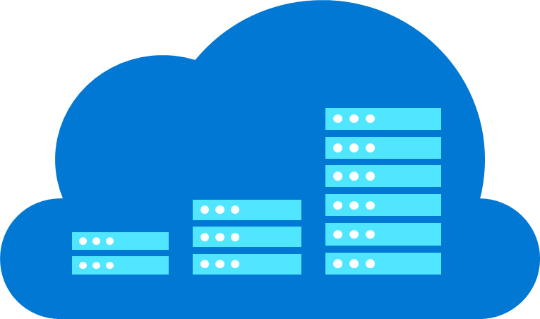
Hyperscale (Citus) vs. scaling storage: Architectural differences
Scale-out storage
Hyperscale (Citus)
Query endpoint
Query endpoint
Primary
Replica
Replica
Data
Node 1
Data
Node 2
Data
Node 3
N#
Shared storage layer
Shared disk: Scale out storage
1 query processed by 1 node
Database not sharded
Scale out each of Memory, CPU, and Storage
1 query can be processed by up to N nodes.
Database sharded transparently to the application
Up to 10 TB of total memory, 100s of TBs of storage

Slide 47

Building applications with Hyperscale (Citus)

Slide 48
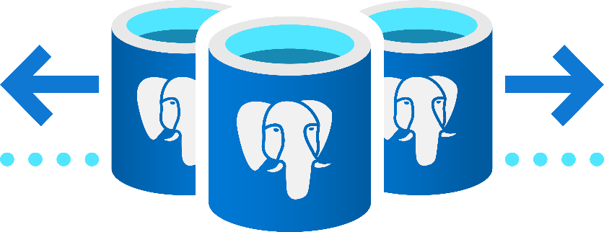
アプリケーションのスケールアウトに Hyperscale (Citus) を利用するベネフィット
水平
スケールアウト
爆速
パフォーマンス
インフラの
シンプル化
PostgreSQL による革新は
現状維持
Break free from the limits of single-node Postgres & scale out across 100s of nodes
Ingest & query your database in real time, with sub-second responses across billions of rows
Save time. Run both transactions and analytics in one database. Also, avoid the painful costs of manual sharding
Developed as an open source extension, leverage all your PostgreSQL expertise and its latest innovations

Slide 49
If you want to scale-out your previous built application…
AKS – Containerized applications
Flexible Server (HA) – PostgreSQL database
Azure Cache – Session states, asset caching
Azure Functions – Alerts
Notification Hubs – Push notice
Azure Databricks – ML analytics and deeper insights
Application Insights – Performance monitoring
Browser
1
7
Content Delivery Network
AKS
Application Insights
2
5
4
3
Notification Hubs
Azure Functions
Azure Cache
for Redis
6
Zone redundant HA – Flexible server
Azure Databricks
Notes:
Deploy and manage containerized enterprise applications (AKS) easily with a continuous integration and delivery experience (CI/CD), and enterprise grade security and governance.
Deploy a fully managed PostgreSQL – Flexible server configured with VNet and zone redundant high availability.
Offload database demands by managing sessions state and asset caching with Azure Cache for Redis
Alert based on key events such as location or user activity using the serverless compute platform of Azure Functions.
Push notifications directly to your users on their preferred service or medium.
Use scalable machine learning/deep learning techniques, to derive deeper insights from this data using Python, R or Scala, with inbuilt notebook experiences in Azure Databricks.
Monitor your application’s performance for degradation or anomalies and auto-scale your application to changing performance requirements.

Slide 50
Easily scale-out with Hyperscale (Citus)
AKS – Containerized OLTP applications
Hyperscale (Citus) – PostgreSQL database
Azure Cache – Session states, asset caching
Azure Functions – Alerts
Notification Hubs – Push notice
Azure Databricks – ML analytics and deeper insights
Application Insights – Performance monitoring
Browser
1
7
Content Delivery Network
AKS
Application Insights
2
5
4
3
Notification Hubs
Azure Functions
Azure Cache
for Redis
Hyperscale (Citus)
6
Azure Databricks
Notes:
Deploy and manage containerized enterprise applications (AKS) easily with a continuous integration and delivery experience (CI/CD), and enterprise grade security and governance.
Deploy a fully managed PostgreSQL – Flexible server configured with VNet and zone redundant high availability.
Offload database demands by managing sessions state and asset caching with Azure Cache for Redis
Alert based on key events such as location or user activity using the serverless compute platform of Azure Functions.
Push notifications directly to your users on their preferred service or medium.
Use scalable machine learning/deep learning techniques, to derive deeper insights from this data using Python, R or Scala, with inbuilt notebook experiences in Azure Databricks.
Monitor your application’s performance for degradation or anomalies and auto-scale your application to changing performance requirements.

Slide 51
Building Real-time analytics with Hyperscale (Citus)
Hyperscale (Citus) in Azure Database for PostgreSQL
Event Hubs - Stream millions of events
Hyperscale (Citus) – ingest raw transactional events
Hyperscale (Citus) – perform incremental rollups
Azure Databricks – transform and analyze from both raw/structured
AKS – Provide insights to users
Push notifications
1
2
4
Devices
Event Hubs
Raw Events
Azure Databricks
3
Scheduled
process
5
4
Browser
App Service/AKS
Aggregations
6
Notification Hubs
Notes:
Stream millions of events per second from devices and sensors into a scalable system that speaks and understands Apache Kafka. Build downstream pipelines to process, manipulate, and ingest your data
Ingest millions of raw transactional events into Hyperscale (Citus) per second, allowing you to query and alert on granular events
Perform incremental rollups directly in your database at granularities you define such as minutely, hourly, daily, to real-time reporting and dashboarding for down stream applications
Take advantage of Azure Databricks to clean, transform, and analyze the streaming data, and combine it with structured data from operational databases or data warehouses
Provide insights to users and operators on current device status
Push timely notifications directly to your users on their preferred service or medium

Slide 52
Building Real-time analytics with Hyperscale (Citus)
Hyperscale (Citus) in Azure Database for PostgreSQL
Event Hubs - Stream millions of events
Hyperscale (Citus) – ingest raw transactional events
Hyperscale (Citus) – perform incremental rollups
Azure Databricks – transform and analyze from both raw/structured
AKS – Provide insights to users
Push notifications
1
2
4
Devices
Event Hubs
Raw Events
Azure Databricks
3
Scheduled
process
5
4
Browser
App Service/AKS
Aggregations
6
Notification Hubs
Notes:
Stream millions of events per second from devices and sensors into a scalable system that speaks and understands Apache Kafka. Build downstream pipelines to process, manipulate, and ingest your data
Ingest millions of raw transactional events into Hyperscale (Citus) per second, allowing you to query and alert on granular events
Perform incremental rollups directly in your database at granularities you define such as minutely, hourly, daily, to real-time reporting and dashboarding for down stream applications
Take advantage of Azure Databricks to clean, transform, and analyze the streaming data, and combine it with structured data from operational databases or data warehouses
Provide insights to users and operators on current device status
Push timely notifications directly to your users on their preferred service or medium

Slide 53
Building Real-time analytics with Hyperscale (Citus)
Hyperscale (Citus) in Azure Database for PostgreSQL
Event Hubs - Stream millions of events
Hyperscale (Citus) – ingest raw transactional events
Hyperscale (Citus) – perform incremental rollups
Azure Databricks – transform and analyze from both raw/structured
AKS – Provide insights to users
Push notifications
1
2
4
Devices
Event Hubs
Raw Events
Azure Databricks
3
Scheduled
process
5
4
Browser
App Service/AKS
Aggregations
6
Notification Hubs
Notes:
Stream millions of events per second from devices and sensors into a scalable system that speaks and understands Apache Kafka. Build downstream pipelines to process, manipulate, and ingest your data
Ingest millions of raw transactional events into Hyperscale (Citus) per second, allowing you to query and alert on granular events
Perform incremental rollups directly in your database at granularities you define such as minutely, hourly, daily, to real-time reporting and dashboarding for down stream applications
Take advantage of Azure Databricks to clean, transform, and analyze the streaming data, and combine it with structured data from operational databases or data warehouses
Provide insights to users and operators on current device status
Push timely notifications directly to your users on their preferred service or medium

Slide 54
Building Real-time analytics with Hyperscale (Citus)
Hyperscale (Citus) in Azure Database for PostgreSQL
Event Hubs - Stream millions of events
Hyperscale (Citus) – ingest raw transactional events
Hyperscale (Citus) – perform incremental rollups
Azure Databricks – transform and analyze from both raw/structured
AKS – Provide insights to users
Push notifications
1
2
4
Devices
Event Hubs
Raw Events
Azure Databricks
3
Scheduled
process
5
4
Browser
App Service/AKS
Aggregations
6
Notification Hubs
Notes:
Stream millions of events per second from devices and sensors into a scalable system that speaks and understands Apache Kafka. Build downstream pipelines to process, manipulate, and ingest your data
Ingest millions of raw transactional events into Hyperscale (Citus) per second, allowing you to query and alert on granular events
Perform incremental rollups directly in your database at granularities you define such as minutely, hourly, daily, to real-time reporting and dashboarding for down stream applications
Take advantage of Azure Databricks to clean, transform, and analyze the streaming data, and combine it with structured data from operational databases or data warehouses
Provide insights to users and operators on current device status
Push timely notifications directly to your users on their preferred service or medium

Slide 55
Building Real-time analytics with Hyperscale (Citus)
Hyperscale (Citus) in Azure Database for PostgreSQL
Event Hubs - Stream millions of events
Hyperscale (Citus) – ingest raw transactional events
Hyperscale (Citus) – perform incremental rollups
Azure Databricks – transform and analyze from both raw/structured
AKS – Provide insights to users
Push notifications
1
2
4
Devices
Event Hubs
Raw Events
Azure Databricks
3
Scheduled
process
5
4
Browser
App Service/AKS
Aggregations
6
Notification Hubs
Notes:
Stream millions of events per second from devices and sensors into a scalable system that speaks and understands Apache Kafka. Build downstream pipelines to process, manipulate, and ingest your data
Ingest millions of raw transactional events into Hyperscale (Citus) per second, allowing you to query and alert on granular events
Perform incremental rollups directly in your database at granularities you define such as minutely, hourly, daily, to real-time reporting and dashboarding for down stream applications
Take advantage of Azure Databricks to clean, transform, and analyze the streaming data, and combine it with structured data from operational databases or data warehouses
Provide insights to users and operators on current device status
Push timely notifications directly to your users on their preferred service or medium

Slide 56
Building Real-time analytics with Hyperscale (Citus)
Hyperscale (Citus) in Azure Database for PostgreSQL
Event Hubs - Stream millions of events
Hyperscale (Citus) – ingest raw transactional events
Hyperscale (Citus) – perform incremental rollups
Azure Databricks – transform and analyze from both raw/structured
AKS – Provide insights to users
Push notifications
1
2
4
Devices
Event Hubs
Raw Events
Azure Databricks
3
Scheduled
process
5
4
Browser
App Service/AKS
Aggregations
6
Notification Hubs
Notes:
Stream millions of events per second from devices and sensors into a scalable system that speaks and understands Apache Kafka. Build downstream pipelines to process, manipulate, and ingest your data
Ingest millions of raw transactional events into Hyperscale (Citus) per second, allowing you to query and alert on granular events
Perform incremental rollups directly in your database at granularities you define such as minutely, hourly, daily, to real-time reporting and dashboarding for down stream applications
Take advantage of Azure Databricks to clean, transform, and analyze the streaming data, and combine it with structured data from operational databases or data warehouses
Provide insights to users and operators on current device status
Push timely notifications directly to your users on their preferred service or medium

Slide 57
Real-time analytics with Hyperscale (Citus)
Hyperscale (Citus) in Azure Database for PostgreSQL
Event Hubs - Stream millions of events
Hyperscale (Citus) – ingest raw transactional events
Hyperscale (Citus) – perform incremental rollups
Azure Databricks – transform and analyze from both raw/structured
AKS – Provide insights to users
Push notifications
1
2
4
Devices
Event Hubs
Raw Events
Azure Databricks
3
Scheduled
process
aka.ms/hyperscale-citus-real-time-tutorial
5
4
Browser
App Service/AKS
Aggregations
6
Notification Hubs
Notes:
Stream millions of events per second from devices and sensors into a scalable system that speaks and understands Apache Kafka. Build downstream pipelines to process, manipulate, and ingest your data
Ingest millions of raw transactional events into Hyperscale (Citus) per second, allowing you to query and alert on granular events
Perform incremental rollups directly in your database at granularities you define such as minutely, hourly, daily, to real-time reporting and dashboarding for down stream applications
Take advantage of Azure Databricks to clean, transform, and analyze the streaming data, and combine it with structured data from operational databases or data warehouses
Provide insights to users and operators on current device status
Push timely notifications directly to your users on their preferred service or medium

Slide 58
Azure Database for PostgreSQL Hyperscale (Citus) ケーススタディ

Slide 59
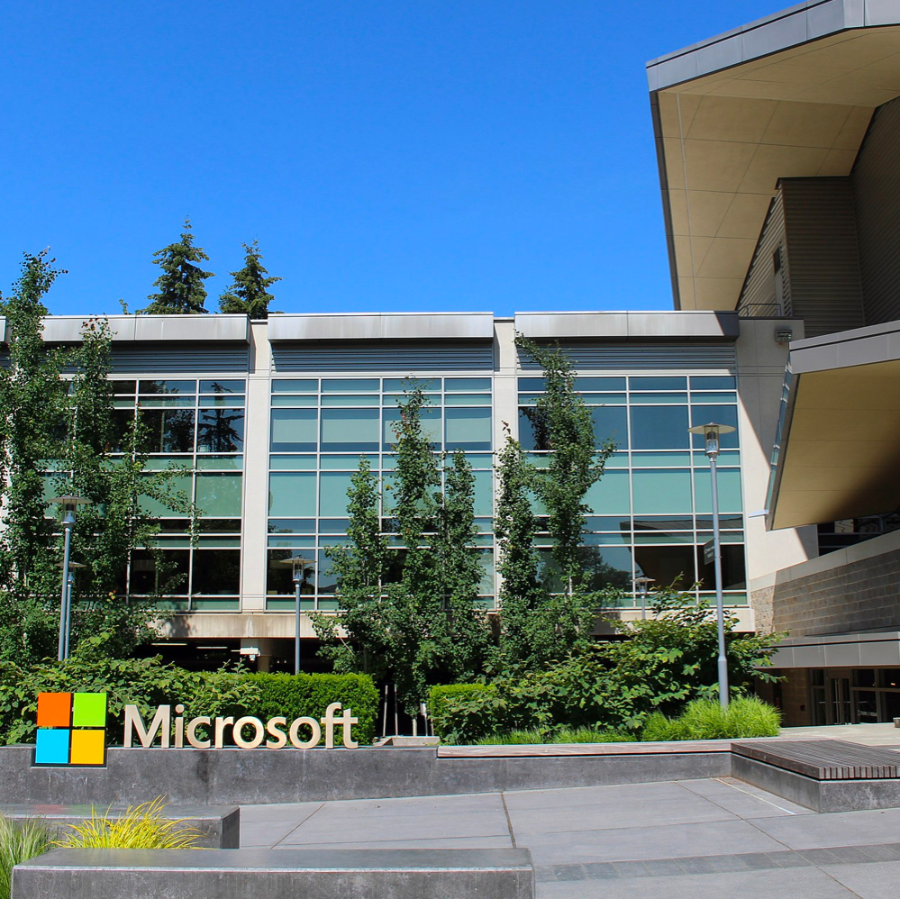
Microsoft Windows team relies on Citus and Postgres (on Azure) for mission-critical shiproom decisions
“Distributed PostgreSQL is a game changer. We can support more than 6M queries every day, on 2 PB of data. With Citus, most of our queries respond in less than 0.2 seconds.”
aka.ms/blog-petabyte-scale-analytics

Slide 60
Microsoft Windows chooses Azure Database for PostgreSQL Hyperscale
Windows was looking for a cloud-based database that could support the volume and velocity of transactions in its diagnostic metrics and improve customer experience during updates
With PostgreSQL Hyperscale, ship/no-ship decisions for Windows were made based on on-the-fly analytics on billions of JSON events with sub-second responses.
Data volume: 1.5 PB+​​
Real-time analytics: 95% queries execute in <4s
Response times: 75% of queries are <200ms
Query volume: >6m daily

Slide 61


Citus helps ASB onboard customers 20x faster
“After migrating to Citus, we can onboard Vonto customers 20X faster, in 2 minutes vs. the 40+ minutes it used to take. And with the launch of Hyperscale (Citus) on Azure Database for PostgreSQL, we are excited to see what we can build next on Azure.”
100 GB+ data​​ ​
Multi-tenant SaaS application
Milliseconds latency
Notes:
Small data but larger bank in new Zealand
They wanted onboarding faster and went from 40 to 2 mins
They are now able to grow the app
Hyperscale (Citus) gives ability to disk, compute and mem to the db as you like
Typically mem is the bottleneck in multitenant arch – Here you can throw hardware at it
In past they’d have to get a bigger box and react and worry again or manually shard
App would have to manage the manual sharding and know where the data is which is extremely painful & complex

Slide 62







Scaling multi-tenant & SaaS applications
Ingest and sync data from disparate sources in real time with transactional guarantees
Offload database demands by managing sessions state and asset caching with Azure Cache for Redis
Shard by tenant and allow Hyperscale to elastically scale out your data. With co-location and tenant isolation features, don’t worry about the scale limits of your database
Use scalable machine learning/deep learning techniques, to derive deeper insights from this data
Report and visualize the state of your devices at a granular or aggregated level
Push timely notifications directly to your users on their preferred service or medium
Tenant (customer)
Azure Cache
for Redis
2
Training & Predictive Experimentation
1
3
4
Data from multiple sources
Azure Kubernetes Service
Hyperscale (Citus) Aggregations
Azure Machine Learning
6
PostgreSQL Power BI Connector
5
Consumers
Notification Hubs
Power BI
Notes:
Think Saas applications built in the cloud – ERP’s, HR platforms, client facing Analytics platforms, banking platforms
Any app that is
Built for cloud
Has a need to grow and scale as their client volume grows
Has need to keep client data separate w/out adding the operational burden of standup a separate DB per client
Or a Saas app that has one really really big client that maybe should be isolated so as not to be a burden on other smaller ones
Deploy on Kubernetes and using notification hubs
Not just Storing data but also using notifications to reach out to customer again
This while having the ability to Elastically scale as you need
___________________________________________________________________________________________________________
MySQL (Oracle): 2nd Quadrant LINK – 1, 1(charter),
Bought by Oracle so now little by little going up. Was $5k/sever but now we see 10k/node
One of the two big OS Relational DB now only PG
Search for PG vs mysql – 2nd quadrants answers are good & Quora
Have good multimaster tool
Only ACID if using InnovDB and NDV cluster storage engines
Common to underperform when strained by heavy loads or complex queries
Better for reads
Does not support indexing for JSON – access speed impact
Only indexes on 1 (btree) while PG has 6 w/in PG along with more from the contributors
Does not support materialized views
Single language support – not extensible
Aurora:
Stepping Stone,
provisioning on Azure is a big leg up we have on AWS right now (41 minutes in Azure, 6 days on AWS).
#1 Aurora is PROPRIETARY vs. Citus = open source + run anywhere + NOT locked into one infrastructure
#2 Aurora ONLY SCALES 2 things: STORAGE & READ performance via max of 15 read-replicas. Whereas Citus can scale out compute, memory, and disk—for both reads and writes—including separate read-replica support if needed (we call the read-replicas followers)
You cannot parallelize queries. 1 query 1 node
Only scales to 64 TB
#3 Aurora is a FORK of Postgres vs. Citus stays current because it’s an extension to Postgres
Index creation, writes, reads, etc all get spread out across different nodes giving you much higher performance
Managed single node PostgreSQL service. Basically, the same as RDS, but with a different storage layer, better marketing, higher prices, and outdated Postgres. Storage layer is interesting because it is 6-way replicated across data centers and does not require pre-provisioning. Provides high availability. Overall system architecture is inspired by Oracle RAC.
Single node: Cannot use the memory/CPU/IO capacity of multiple machines
No parallel query - this may change in the future, but will always remain *very* limited compared to Citus
Very hard to migrate off
High IO costs – you pay $0.20 per 1M I/O operations in top of hardware costs, which is as obscure as it sounds. In practice, it means you pay about $25 for writing or reading a TB of data. Many Citus users write several TB per day and may read up to 100TB per day.
Aurora multi-master replication – released a week ago
Does that create more connections?
How does that affect concurrency when at full load?
Positives:
Aurora is good at OLTP apps for databases <100GB (same as RDS/Heroku/etc.)
Amazon's marketing suggests Aurora scales, but this is not comparable to the way distributed database scale. The storage layer has a cap of 64TB and ~300MB/s write capacity. You still only have single-node PostgreSQL instance of at most 32 cores/488GB.
You can have read replicas (again, same as RDS/Heroku/etc.), but every replica will have roughly

Slide 63
Copper saves millions of dollars, with developers focused on building apps vs. sharding databases
CRM Application
Multi-tenant
Heavily relational
Heavy users of Postgres but hit a wall
Considered NoSQL, Manual sharding
3TB​ of live CRM data 70% faster deployment
55K+ ops / minute
Ability to grow >10x
“Citus was the fastest and best way to protect our engineering throughput while still scaling the database.”
– Kelly Cheng, CTO

Slide 64
Building high throughput transactional apps
Ingest millions of events per second from devices and sensors into a scalable system that speaks and understands Apache Kafka. Build downstream pipelines to process, manipulate, and manipulate your data
Efficiently store and retrieve billions of records per day with sub second latency with Hyperscale (Citus).
Provide millisecond latency lookups across large data sets to apps coordinated with end users
Offload database demands by managing sessions state and asset caching with Azure Cache for Redis
Deliver data to the application for internal reporting and insights on health of devices and systems
Use scalable machine learning/deep learning techniques, to derive deeper insights from this data using Python, R or Scala, with inbuilt notebook experiences in Azure Databricks
5
4
Browser
App Service
Azure Cache
for Redis
3
1
2
Browser
Event Hubs
Hyperscale (Citus)
6
Azure Databricks
Notes:
Then of course, High throughput online / real-time transactional workloads
Large ingest of data
Millisecond latency for high throughput transactions
High concurrency
Are done well by the Citus platform
Next I’ll walk through a few features of both single node and the Hyperscale (Citus) scalable PG offering but any questions so far?
___________________________________________________________________________________________________________
Potential questions:
Cosmos
Good when u know its key value and one type of workload
TCO high – you have to piece together Spark or HDInsight and processing in Spark and store & display in cosmos
Complexity high
Citus:
SQL – relational but also good for semi-structure/JSON
TCO less with Citus because its flexible and you don’t need to piece spark, plus cosmos plus datalake
Complexity low – 1 solution vs piecing together multiple pieces
More flexible – PG joins, json, better for multiple types of workloads
Oracle:
Financial
Open source
Cloud native
MySQL (Oracle): 2nd Quadrant LINK – 1, 1(charter),
Bought by Oracle so now little by little going up. Was $5k/sever but now we see 10k/node
One of the two big OS Relational DB now only PG
Search for PG vs mysql – 2nd quadrants answers are good & Quora
Have good multimaster tool
Only ACID if using InnovDB and NDV cluster storage engines
Common to underperform when strained by heavy loads or complex queries
Better for reads
Does not support indexing for JSON – access speed impact
Only indexes on 1 (btree) while PG has 6 w/in PG along with more from the contributors
Does not support materialized views
Single language support – not extensible
Aurora:
Stepping Stone,
provisioning on Azure is a big leg up we have on AWS right now (41 minutes in Azure, 6 days on AWS).
#1 Aurora is PROPRIETARY vs. Citus = open source + run anywhere + NOT locked into one infrastructure
#2 Aurora ONLY SCALES 2 things: STORAGE & READ performance via max of 15 read-replicas. Whereas Citus can scale out compute, memory, and disk—for both reads and writes—including separate read-replica support if needed (we call the read-replicas followers)
You cannot parallelize queries. 1 query 1 node
Only scales to 64 TB
#3 Aurora is a FORK of Postgres vs. Citus stays current because it’s an extension to Postgres
Index creation, writes, reads, etc all get spread out across different nodes giving you much higher performance
Managed single node PostgreSQL service. Basically, the same as RDS, but with a different storage layer, better marketing, higher prices, and outdated Postgres. Storage layer is interesting because it is 6-way replicated across data centers and does not require pre-provisioning. Provides high availability. Overall system architecture is inspired by Oracle RAC.
Single node: Cannot use the memory/CPU/IO capacity of multiple machines
No parallel query - this may change in the future, but will always remain *very* limited compared to Citus
Very hard to migrate off
High IO costs – you pay $0.20 per 1M I/O operations in top of hardware costs, which is as obscure as it sounds. In practice, it means you pay about $25 for writing or reading a TB of data. Many Citus users write several TB per day and may read up to 100TB per day.
Aurora multi-master replication – released a week ago
Does that create more connections?
How does that affect concurrency when at full load?
Positives:
Aurora is good at OLTP apps for databases <100GB (same as RDS/Heroku/etc.)
Amazon's marketing suggests Aurora scales, but this is not comparable to the way distributed database scale. The storage layer has a cap of 64TB and ~300MB/s write capacity. You still only have single-node PostgreSQL instance of at most 32 cores/488GB.
You can have read replicas (again, same as RDS/Heroku/etc.), but every replica will have roughly

Slide 65
Pex cuts hardware costs by 60%, serving sub-second queries on terabytes of data
High throughput OLTP with analytics
Low-latency
Strong consistency
Relational features including joins, triggers
Replacing Hadoop / HBase
Tried Cassandra
80TB+ of data
60k TPS
80B rows updated / day
1280 CPU cores
21 Citus nodes (60% reduction from 55 nodes on HBase)
“We would not be able to fulfill our data processing needs with any other database. And we tried! We really, really tried.”
- Rasty Turek, CEO

Slide 66

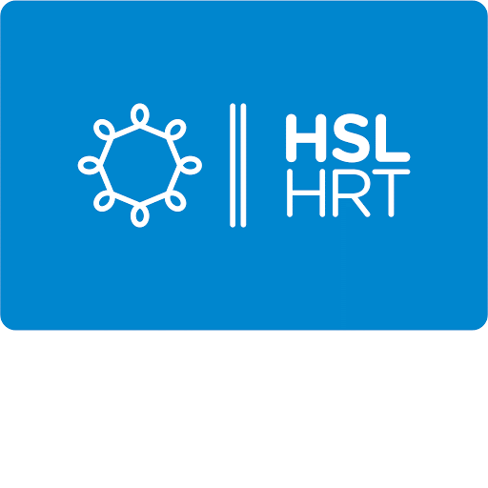
Transit authority improves traffic monitoring with Azure Database for PostgreSQL Hyperscale
“Along with much better performance, moving to Hyperscale has reduced operational costs by over 50 percent.”
Sami Räsänen, Product Owner and Team Lead at HSL
Notes:
https://customers.microsoft.com/en-us/story/845146-transit-authority-improves-traffic-monitoring-with-azure-database-for-postgresql-hyperscale
Helsinki Region Transport Authority (HSL) is responsible for more than half of all public transportation in Finland. Every day, over 1 million journeys are made on HSL bus, train, Metro, tram, and ferry services. To help log and monitor this traffic more efficiently, HSL replaced its on-premises PostgreSQL solution with a new system using Azure Database for PostgreSQL Hyperscale (Citus). The new solution dramatically improved performance while also reducing operating costs.

Slide 67
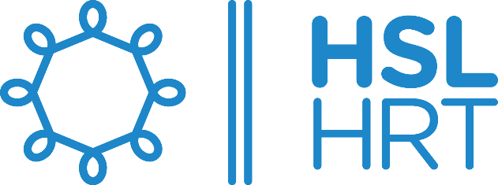




Build innovative applications and reduce TCO with Azure Database for PostgreSQL
Modern transactional apps built with AKS
Enable real-time operational analytics apps
Build geospatial enabled Apps
Combine time series and relational data
Migrate Oracle databases to Azure and reduce TCO
Engage cloud native developers with the flexibility of AKS and extensibility of PostgreSQL
Converge transactional and operational data stores, leveraging Hyperscale
Leverage PostGIS, the world’s most popular OS geospatial solution to deliver location-aware experiences
Power just-in-time decision-making for event driven applications
Complete migrations faster and realize significant cost savings while enabling hyperscale

Slide 68

御社のインフラ内にフルマネージドの Azure Database for PostgreSQL を導入したい場合…

Slide 69
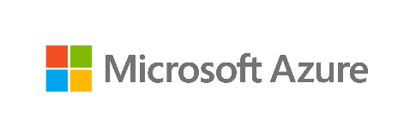




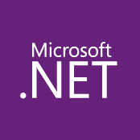



背景: ますます複雑化するシステム環境
10s–1,000s of apps
Diverse infrastructure
Multi-cloud
VMs
Databases
Datacenters
Hosters
Containers
Serverless
Branch offices
OEM hardware
IoT devices
Edge
Notes:
How to govern and operate disparate environments at scale?
How to ensure integrated security across the entire organization?
How to best enable innovation and developer agility?

Slide 70

Azure Arc enabled PostgreSQL Hyperscale - Azure Arc 対応 データ サービスの 1メニューとして

Slide 71



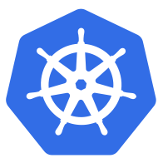

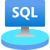
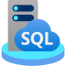



Azure ハイブリッド
Innovation anywhere with Azure
Microsoft Azure
Azure Stack
Azure Arc
Azure IoT
統合されたシステム
あらゆるデータセンター, あらゆるクラウドで
あらゆるエッジデバイスで
Management | Security + Identity | App + Data Services | Dev Tools + DevOps

Slide 72
Azure Arc enabled PostgreSQL Hyperscale とは?
“Azure Postgres” のデプロイ選択肢の一つ
Azure Arc enabled data services の一つ
PostgreSQL Azure PaaS サービスのハイブリッドソリューション。パブリッククラウド (Azure, AWS, GCP) とエッジ、あらゆるインフラで動作。
スタンダードな PostgreSQL が分散データベースシステムに。
かつてないレベルのスケールとパフォーマンスを実現。
マルチテナント アプリケーション や リアルタイム分析に最適
Notes:
It is one of the services offered with Azure Arc. Azure Arc is a hybrid solution that brings Azure PaaS services to any physical infrastructure: on your premises, in public clouds (Azure, AWS, GCP) and at the Edge.
Azure Arc enabled PostgreSQL Hyperscale runs the standard PostgreSQL database engine along with the Open Source Citus extension.
Together they transforms the standard PostgreSQL database engine into a distributed database that offers unprecedented levels of scale and performance.

Slide 73


Azure Arc enabled PostgreSQL Hyperscale
Bring Azure data services to on-premises, multi-cloud (Azure, AWS, GCP), and edge with Azure Arc
Connected or Disconnected
Always current
Elastic scale
Unified management
Unmatched security
Cloud billing
Automated updates
Hyperscale (Citus) on-premises
Deploy in seconds
Scale up, scale out
Automation at scale
Single view for
on-prem and clouds
Use familiar tools
Azure Policy
Role-based Access Control
Cloud billing on-premises
Cost efficiency
aka.ms/azurearcdata
Any hardware, any Kubernetes

Slide 74
PostgreSQL anywhere: Azure Arc 対応データ サービス
PREVIEW
Azure Database for PostgreSQL Hyperscale
PREVIEW
Azure SQL Database
Connected / Indirect-connected
Cloud benefits for both connected and intermittently connected scenarios
常に最新
自在にスケール
統合管理
Automated updates
Evergreen SQL
Hyperscale on-premises
Deploy in seconds
Scale up, scale out
Automation at scale
Single view for on-prem and clouds
Use familiar tools
aka.ms/AzureArc (PREVIEW)
Any hardware, any Kubernetes
Notes:
With Azure Arc, you can now bring Azure data services to any infrastructure across on-premises data centers, edge and 3rd party clouds, using Kubernetes on hardware of your choice. For customers who need to maintain data estate on-premises, you will gain unique benefits for those on-premises data workloads.
First, you will always be current, meaning updates and upgrades are fully automated, and the deployment is controlled by your policy. You will gain unique and cloud proven innovation ahead of any other hybrid cloud offering like the evergreen SQL with no end-of-support through Azure SQL Database, and the hyperscale deployment option of Azure Database for PostgreSQL.
Second, we will bring cloud elasticity on-premises so you can optimize performance of data workloads with the ability to dynamically scale up/down and scale out, without application downtime.
Moreover, by connecting to Azure you will gain unified management. Imagine being able to see your data services running on-premises along side those running in Azure through a single pane of glass, using familiar tools like Azure Portal, Azure Data Studio and Azure CLI.
For the first time, you will be able to access Azure’s industry leading security and governance capabilities to your on-premises data workloads using Azure Security Center, Azure policy and Azure RBAC to protect your data on-premises.
Best of all, you can now have the option to use modern cloud billing model for better cost efficiency across your hybrid infrastructure.

Slide 75
Connectivity Modes Of Azure Arc enabled Data Services
Built-in capabilities | Connectivity Mode To Azure
 | Indirect Connect Mode | Direct Connect Mode
Automatic HA/DR
Self-service provisioning
Elastic scalability
Billing
Auto upgrade, patching
Auto backup-restore
Monitoring
Authentication
Role-Based Access Control (RBAC)
Inventory in Azure
User experiences/tools
Security services
Using Kubernetes tools, Azure Data Studio, or azdata CLI
+Using Azure Portal, Azure Policy, az CLI
Using Kubernetes tools, Azure Data Studio, or azdata CLI
+Using Azure Portal, Azure Policy, az CLI
Export/upload to Azure. Some delay in visibility to costs incurred depending on upload frequency
Automatic, continuous feed of billing usage telemetry to Azure
Container images must be pulled/pushed to a local registry
Container images come automatically, directly from Microsoft Container Registry
Local backup/restore service for scheduled, frequent, fast backups and restores.
+Auto send backups to Azure Backup/blob storage for long-term, offsite retention
Local monitoring and log analytics. Manually export and upload to Azure Monitor.
+Auto send monitoring and logs to Azure Monitor. +Container Insights
Basic login/password
Active Directory
+Azure Active Directory
Basic, local RBAC
+Integrated with Azure RBAC
Export/upload to Azure
Automatic sync to Azure
Kubernetes tools, Azure Data Studio, or azdata CLI locally
+Azure Portal, Azure Policy, az CLI
Advanced Threat Protection
Vulnerability Assessment
Items in burgundy text are optional, add-on Azure services with their own pricing model.

Slide 76
Roles And Responsibilities: Azure PaaS Vs. Azure Arc
Azure Platform As A Service (PaaS)
Azure Arc data services
Who provides the infrastructure?
Microsoft
Customer
Who provides the software*?
Microsoft
Microsoft
Who does the operations?
Microsoft
Customer
Does Microsoft provide SLAs?
Yes
No
Who’s in charge of SLAs?
Microsoft
Customer/Vendors
Exception: infra hosted in Azure
(example: AKS) and yet…
Because Microsoft does not own infra & does not operate Arc deployments
Why?
*Azure services

Slide 77

Azure は PostgreSQL の 最良のデプロイ先に

Slide 78
Azure は PostgreSQL の最良のデプロイ先に
Azure データ エコシステムとの統合
フルマネージド
高度にスケーラブル
どこでも実行
セキュリティと
コンプライアンス
Hyperscale (Citus)
Azure Arc
オープンソース
実証済みのレジリエンス
と安定性
リッチな機能セット
Collaborate & contribute
Available via Azure: Any scale. Anywhere
Notes:
And last but definitely not the least, we provide integration points with Active Directory Integration, Azure Data Factory and PowerBI so that you can build your application end to end on Azure.

Slide 79
複数のデプロイモードでアプリケーションの要求に適合
Flexible Server
Control, Flexibility, HA, and simplified developer experience
Hyperscale (Citus)
Distributed database that provides unlimited scalability
Single Server
Fully managed PostgreSQL service
Azure
aka.ms/azure-postgres
PostgreSQL Hyperscale – Azure Arc
Run Hyperscale (Citus) workloads in your infrastructure
Notes:
Microsoft Azure is the cloud that lets you turn ideas into solutions with more than 100 services to build, deploy, and manage applications—in the cloud, on-premises, and at the edge—using the tools and frameworks of your choice. Our track record of continuous innovation supports your development today and your visions for tomorrow. Over the past year, we’ve launched over 1000 capabilities on the platform, helping our customers be future-ready. The cloud is moving fast – every week a new technology is coming out. So it’s about meeting new capabilities now and investing in those on the horizon.
In the world of data, we are committed to empowering organizations to build on their terms with flexibility and choice, and that includes the freedom to operate anywhere.
Nothing is more important than trust, particularly when you’re talking about the cloud. We spend $1B a year on cyber security with 3500 cyber security engineers who are constantly monitoring your data for threats. We’ve invested ahead of the curve in layers of security with built-in controls to protect your data and close the gaps that attackers can exploit. Trust your workloads to Azure, built upon the most secure cloud with the broadest compliance coverage.
Break through the resource constraints of modern application development with limitless scale that goes far beyond other cloud providers.
Modernize existing apps or build new apps on Azure with built-in, AI-based technologies that power new customer experiences.
Azure can help you innovate today, tomorrow, and in the future. We are constantly providing capabilities that can help meet your needs.

Slide 80
PostgreSQL: コミュニティサポートのある 最良のオープンソースデータベース
Open Source
Proven resilience & stability
Rich feature set
Identity, security, management, and compliance
Available in Microsoft Azure
Notes:
And last but definitely not the least, we provide integration points with Active Directory Integration, Azure Data Factory and PowerBI so that you can build your application end to end on Azure.

Slide 81
+ Azure のベネフィット
Fully managed
Intelligent Performance
Highly scalable
High Availability
Maximum control
Open Source
Proven resilience & stability
Rich feature set
Identity, security, management, and compliance
Available in Microsoft Azure
Notes:
And last but definitely not the least, we provide integration points with Active Directory Integration, Azure Data Factory and PowerBI so that you can build your application end to end on Azure.

Slide 82
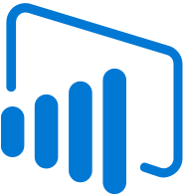


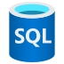

+ Azure エコシステムとの統合
Integrated with Azure data ecosystem
Fully managed
Intelligent Performance
Highly scalable
High Availability
Maximum control
Open Source
Proven resilience & stability
Rich feature set
Identity, security, management, and compliance
Available in Microsoft Azure
Notes:
And last but definitely not the least, we provide integration points with Active Directory Integration, Azure Data Factory and PowerBI so that you can build your application end to end on Azure.

Slide 83
Azure は PostgreSQL の最良のデプロイ先に
Best of open source community along with the manageability and integration benefits of Azure
Integrated with Azure data ecosystem
Fully managed
Intelligent Performance
Highly scalable
High Availability
Maximum control
Open Source
Proven resilience & stability
Rich feature set
Identity, security, management, and compliance
All Available in Microsoft Azure
Notes:
And last but definitely not the least, we provide integration points with Active Directory Integration, Azure Data Factory and PowerBI so that you can build your application end to end on Azure.

Slide 84

Azure は PostgreSQL の最良のデプロイ先に
Best of open source community along with the manageability and integration benefits of Azure
Integrated with Azure data ecosystem
Extend to non-Azure architectures using Azure Arc
Fully managed
Intelligent Performance
Highly scalable
High Availability
Maximum control
Open Source
Proven resilience & stability
Rich feature set
Identity, security, management, and compliance
All Available in Microsoft Azure
Notes:
And last but definitely not the least, we provide integration points with Active Directory Integration, Azure Data Factory and PowerBI so that you can build your application end to end on Azure.

Slide 85
Open Source = PostgreSQL = Value
One of the most loved and wanted databases in Stack Overflow’s 2019 Developer Survey
Ranked 2017 and 2018
DBMS of the Year
by DB-Engines
https://insights.stackoverflow.com/survey/2019?utm_source=so-owned&utm_medium=blog&utm_campaign=dev-survey-2019&utm_content=launch-blog
https://db-engines.com/en/blog_post/76

Slide 86

Why PostgreSQL?
PostgreSQL is more popular than ever
Open source
Proven resilience & stability
Rich feature set
Large developer community
Thousands of mission critical workloads
Solves a multitude of use cases
Extensible
Integration and tooling
Battle tested & enterprise-ready
Zero data loss
Flexible data: Relational & JSON
Rich indexing and data types, including geospatial
Notes:
So why is PG so popular?
Postgres is Open source which is financially palatable for many ☺
Huge community invested in building the product
Has consistent annual major releases with new functionality
This powerful functionality leads to both robustness
and the long history, 22 years, leads to stability.
So it’s battle tested and hardened
Lastly its viewed in the market as a platform to be confident in:
Some recent recognition is:
PG is continuously growing in popularity
Top in “most loved” and “wanted” by Stack Overflows ‘19 survey
DBMS of the year now 2 years in a row by DB-Engines
Now feature-wise [CLICK]
Sources:
https://insights.stackoverflow.com/survey/2019?utm_source=so-owned&utm_medium=blog&utm_campaign=dev-survey-2019&utm_content=launch-blog
https://db-engines.com/en/blog_post/76
https://db-engines.com/en/ranking_trend/system/PostgreSQL

Slide 87

Why PostgreSQL?
PostgreSQL is more popular than ever
Rich selection of datatypes including text based, numeric, arrays, geospatial, IP, key/value, and JSON
Powerful built-in functions to make working with data easier
Multiple index types to allow for fine tuned performance
Built-in JSON support including indexing of all keys/values within a JSON document for fast retrieval and querying
Rich set of extensions to enable new functionality without relying on new Postgres versions/releases. This includes things like hypothetical indexing, geospatial support, time series partitioning
Notes:
The community behind PG has contributed a lot to its development; including MSFT contributions.
For instance: [MAKE CONVERSATIONAL/FLUID]
Its not just Structured data. You can use semi-structured, key value, geo spatial, IP’s, etc – and you're also most likely able to index on those to increase speed & performance
PG has support for wide variety of indexes (json, gin, brin, btree, and others). Not just one type of index
And its not just storage but can query very fast
Built in functions which Citus also takes advantage of like mapping, to allow computation in the DB
Theres Functions to match and convert. Maybe for instance where a road intersects a lake.
But done w/in the DB
It has JSON
not just storage and retrieval but indexing w/in json objects
So with non relational and semi-structure data it uses the indexing concept for fast retrieval
And further you can extend PG to much more functionality by allowing extensions beyond just the core:
Examples are:
Postgis – geo spatial, (don’t start from scratch)
Time series – PG Partman or timescale for faster perf when querying on time,
Fast approximations to do count distinct or find 10 N object in a database with - HLL, TopN
and PGCron to run jobs w/in the DB
Postgres has a lot of functionality and worldwide engineer and developer support. BECAUSE of this PG is gaining momentum in both adoption and satisfaction while many other DB’s are stagnant on that chart.
Sources:
https://insights.stackoverflow.com/survey/2019?utm_source=so-owned&utm_medium=blog&utm_campaign=dev-survey-2019&utm_content=launch-blog
https://db-engines.com/en/blog_post/76
https://db-engines.com/en/ranking_trend/system/PostgreSQL

Slide 88
Azure builds upon the core benefits of PostgreSQL and Open Source
Security
Intelligent performance
Global reach
Extensions
Compliance
Rich indexing
JSONB
Scale up & out
Geospatial support
Full text search
Extension support
Azure Database for PostgreSQL is fully-managed, community PostgreSQL
Easy ecosystem integration
Built-in HA

Slide 89
Azure Database for PostgreSQL ケーススタディ

Slide 90


HarvestMark chooses Azure over Amazon for improved security and performance
“We took an instance of the database, copied it to Azure, then spun it up in the Azure managed PostgreSQL environment. It happened flawlessly in two hours…. The services and utilities, plus technical support, from Microsoft made all the difference”
Todd Berg, Head of Product and Customer Success at HarvestMark

Slide 91

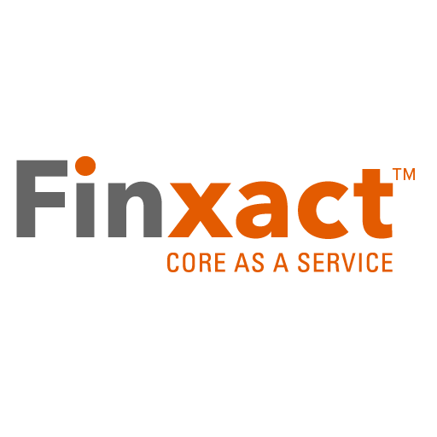
Finxact banks on Azure Database for PostgreSQL for core financial services
“The availability of open-source services on Azure enabled Finxact to leverage the most advanced solutions to support our customers’ business needs at massive scale.”
Frank Sanchez, CEO at Finxact
Notes:
https://customers.microsoft.com/en-us/story/822002-finxact-banks-on-azure-for-core-financial-services
A bank’s core software handles its most critical transactions, yet most banks still run expensive mainframe systems that can’t keep pace with a rapidly changing marketplace. Finxact is the innovator behind a new approach to a bank’s system of record—the core services that handle deposits, loans, and other banking functions. Finxact Core as a Service is a modern, cloud-native banking platform on Azure based on open-source components, and it’s giving agile banks a competitive edge.

Slide 92
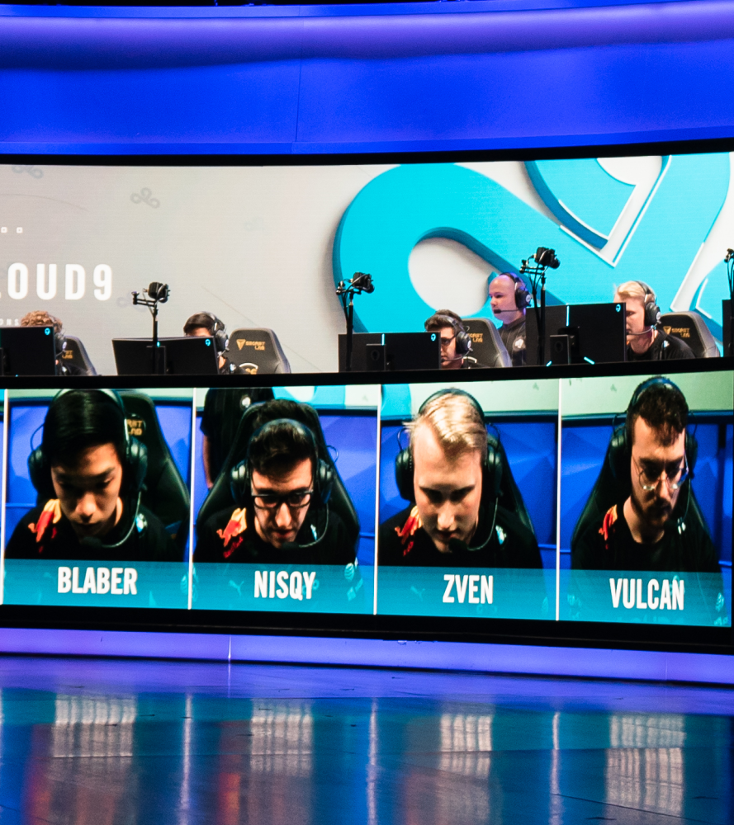
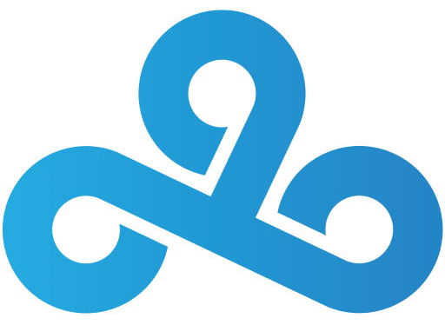
Esports players gain a competitive edge with Azure Database for PostgreSQL
“We can spin up resources as needed and turn them off when we’re done so we aren’t paying for idle compute resources when we don’t need to. Also, by using Azure Database for PostgreSQL, we can focus on the health and delivery of our application, rather than database management, which is taken care of through this service.”
Danny Brady, Senior Data Engineer at Cloud9
Notes:
https://customers.microsoft.com/en-us/story/782270-cloud9-esports-gaming-azure-power-bi
Competitive esports organization Cloud9 fields 14 teams across 12 of the most popular esports. To give its teams an edge over opponents, Cloud9 has brought in data scientists and embraced the power of cloud computing with Microsoft Azure. With data tools like Microsoft Power BI, Cloud9 saves time and gives its players, coaches, and executives meaningful insights into individual and team performance. These insights help Cloud9 better the competition—simultaneously boosting its profile and the popularity of esports.

Slide 93

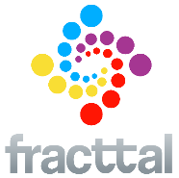
IoT firm reports 10x growth while preserving existing investments in PostgreSQL
“We had essentially become database administrators, which is not how we want to spend our time. With Azure Database for PostgreSQL, we’ll be able to focus on application development, which is the key to our success.”
Azure Database for PostgreSQL
Notes:
https://customers.microsoft.com/story/fracttal-professionalservices-azure
Fracttal is a company based in Chile specializing in building IOT based solution for the manufacturing industry.
IoT provider sought to standardize on a reliable cloud platform while preserving existing investments in open-source software, including its PostgreSQL database. They initially used Amazon Web Services for one year, including the Amazon Relational Database Service, but switched to Microsoft Azure and its Azure Database for PostgreSQL technology. Now, they gains exceptional service and attention from Microsoft, new customer opportunities, and a database solution that supports exponential growth.
The manageability of Azure freed up their developer time to focus more on applications than worry about database maintenance

Slide 94

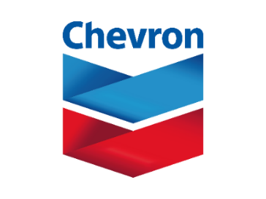


Customer Spotlight – PostgreSQL
Campaign – multi-channel, full customer journey, digital marketing solution
Smart Audit platform – micro-service based ML services and recommendations for assurance
OpenText Documentum – Oracle to Azure DB for PostgreSQL migration
Food Traceability platform – AWS Aurora to Azure DB for PostgreSQL

Slide 95
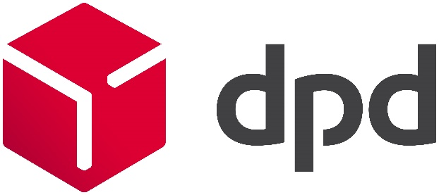


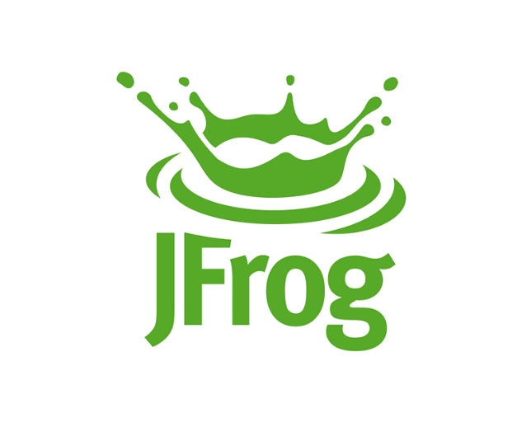
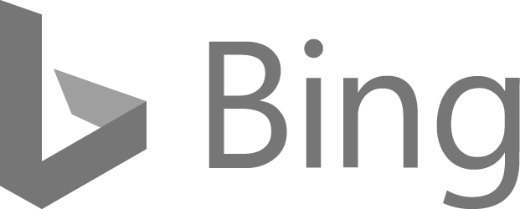





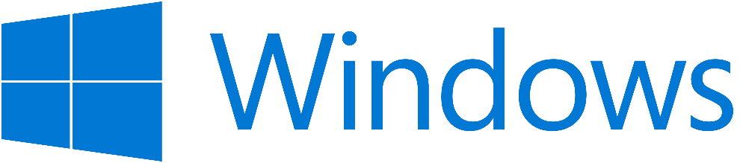

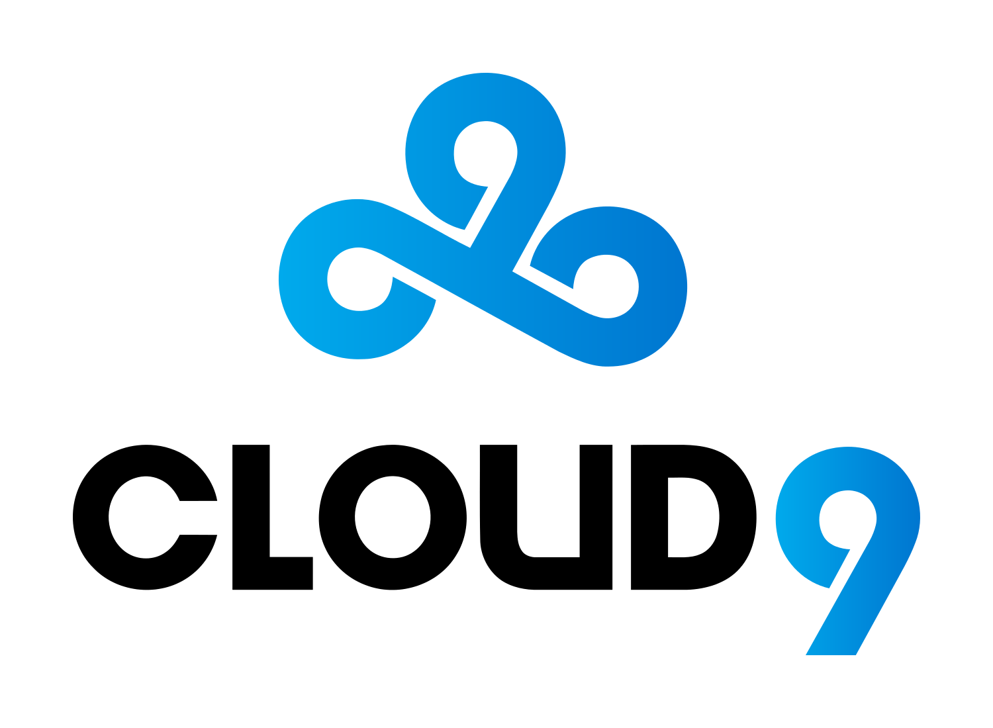





"Azure Database for PostgreSQL gives us the richness of relational SQL, open source extensibility, and the operational simplicity to run at JFrog scale. We are able to provide an End-to-End DevOps platform that customers depend on every day to handle mission-critical workloads."
Casey O'Mara, Director of Cloud Alliance at JFrog

Slide 96
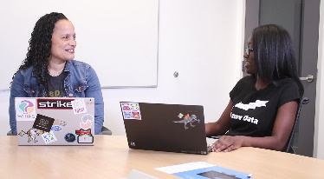
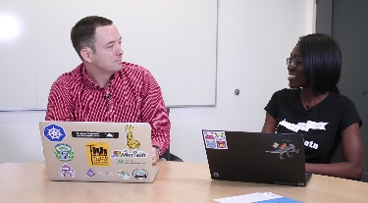






顧客ユースケースをご紹介する短い簡単なデモビデオ
Cognitive Services を使ったインテリジェントなアプリケーションの構築
Azure のオープンなサービス ブローカーを使った Kubernetes 上で動くアプリケーションとの接続
アプリケーションのデータを Power BI に接続してクリティカルなインサイトをもたらすレポートを作成
最小限のダウンタイムで PostgreSQL アプリケーションを Azure に移行する
Watch video
Watch video
Watch video
Watch video

Slide 97
まとめ
Microsoft はオープンソースにコミットし、人材と資金の両面で投資をすることで、その発展に貢献していることをご説明しました。
Microsoft はオープンソースをサービスに取り込むことで、その価値をお客様にお届けしていることをご説明しました。
その特筆すべき一例として、Azure における PostgreSQL をご紹介いたしました。オープンソースと共生する Microsoft ならではの価値提供形態をご覧いただきました。

